Slide 1
Optimizing Solr Caching for VuFind
Benjamin Wiens

Slide 2
Apache Solr
Most popular search platform (netflix, instagram, etc.)
More ASF products: HTTPS Server, Tomcat
Powerful features
Full-text search
Faceted (category) search
Database integration
Highly scalable
Caching

Slide 3
Pull Request #146

Slide 4
Why Optimize Solr Caching
Pull Request #146 (follow along)
Out of Memory (OOM) Issues for some users
Mailing List Suspicion
VuFind Summit 2013
Personally affected

Slide 5
Generic Setup
SolrMarc: MARC metadata imported into “biblio” index on Solr used by VuFind
Notes:
Often times the Solr Engine is on a separate server

Slide 6
Solr Caching
Caching reduces duplicate work
Avoid searching entire index
VuFind’s Solr install utilizes
filterCache – greatest potential of memory consumption
queryResultCache – light weight
documentCache
Notes:
* Adjusting the queryResultCache; documentCache was more of a byproduct,

Slide 7
In the beginning..
Hunch: filterCache too large
<filterCache size=300000>
But who set it?
Solr configs vary dep on
usage/index;
Solr wiki 16000 for special case
Caused OOM occasionally
Prove in test environment
SolrMeter
Stress test
Mimic production (logs)
Notes:
<!--NOTE! size and autowarmCount are very large and illustrating settings for using facet.method=enum (see note above)! -->

Slide 8
Realistic Test Environment
Large environment: Harvard Bibs (13 million)
Logged Production Solr Queries and generated many more
1000 queries per second
VuFinds default heap settings +
Notes:
/usr/local/vufind/solr/jetty/logs/ log location
Harvard bibs imported without extra formatting with into the solr index

Slide 9
Confirmation
Reproduced OOM & showed filterCache responsible
Much smaller filterCache’s – no OOM
Mathematical Explanation
Filter queries are looked up in Solr’s filterCache (if enabled)
http://localhost:8983/solr/select?
&fq=language:german -- filter results to German documents

Slide 10
filterCache Key
Filter query’s are looked up in the filterCache
Entry in the filterCache could look like this:
&fq=language:german
Bit Array results [1, 0, 0, 0, 1, 0 , 0, 1, …, 0]
This array stretches across the entire index
Bit array / Key is stored in heap memory
Notes:
* Unless there are very few results, then the bit representation is different

Slide 11
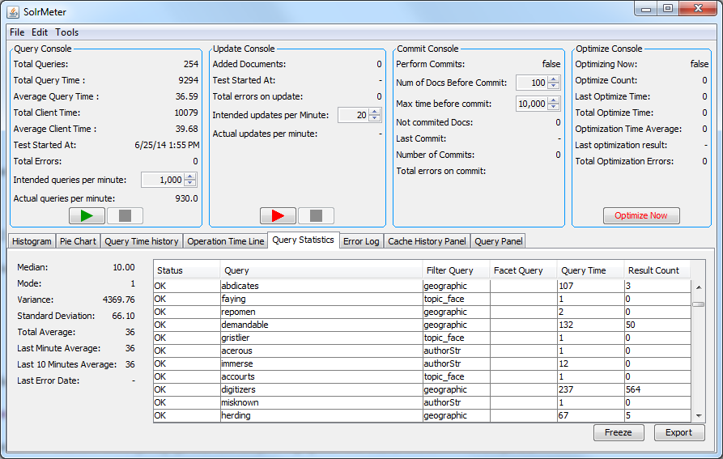
SolrMeter

Slide 12
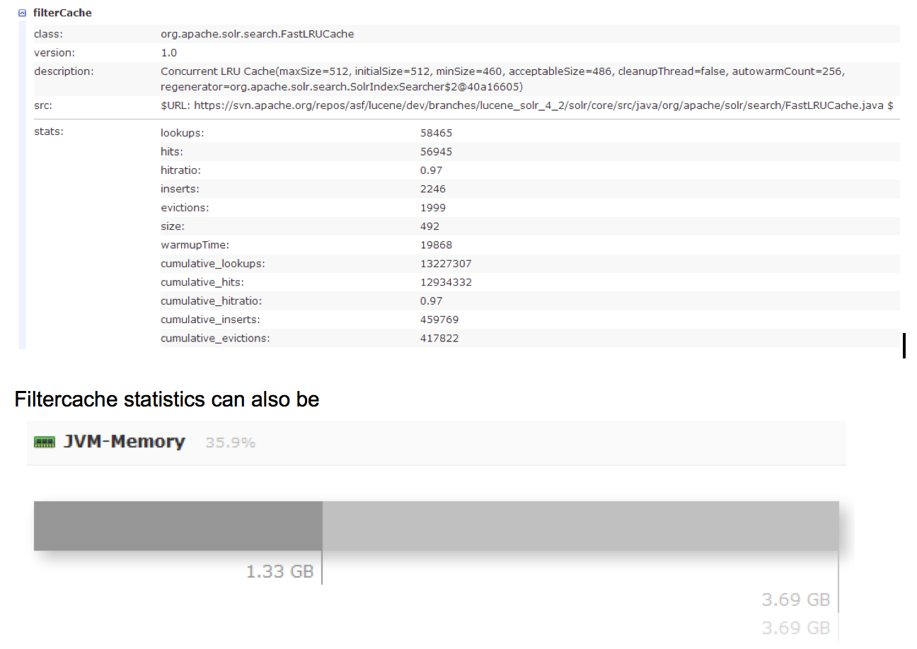
Solr UI
Notes:
useful resource to monitor is the heap memory usage that can be found in the Solr UI

Slide 13
Balance (hit ratio)
Large filterCache size allows high memory consumption
Low filterCache size produces low hit ratio
maxDoc - (MaxDocuments)from the Solr UI
maxDoc/8 – bit to byte
Size – filterCache Size
128 - text of the fq clause
10 million docs, filterCache size 512 = 610mb

Slide 14
Production
calculate filterCache memory consumption
Use SolrMeter in a test environment (optional)
Carefully test production, slowly increasing filterCache size
Monitor Solr statistics

Slide 15
Monitor Production
echo `date -u` >> filterCache-log.txt && curl -sS http://solrserver/solr/biblio/admin/mbeans?stats=true >> filterCache-log.txt (Demian)
Cron for average / trends
Goal is a good hit ratio (~75-99%); acceptable evictions
<filterCache class="solr.FastLRUCache" size="512" initialSize="512" autowarmCount="256"/>
Notes:
Create an average and evaluate statistics with cron

Slide 16
documentCache
Holds documents fetched from index
Sensitive to number of fields indexed for each document
Maximum size should be more than concurrent queries * max number of documents that can be fetched by query
*Guarantees no document fetched twice while processing another query
HAProxy to see max concurrent queries

Slide 17
Conclusion
Start with Solr’s default settings and tweak carefully
Monitor closely with SolrUI and scripts
Hit ratio’s
Evictions
Memory Usage
Use SolrMeter for stress testing when necessary

