Slide 1
Fault-tolerant and Load-balanced VuFind
Ere Maijala
VuFind Summit 2015

Slide 2
Project Background
Part of the National Digital Library initiative
A discovery interface for all Finnish archives, libraries and museums
Initially based on a commercial product
Insufficient for the needs
Development of VuFind-based service started in the beginning of 2012
Older services had planned (and unplanned) downtime due to updates, backups, configuration changes etc.
Try to make things better this time

Slide 3
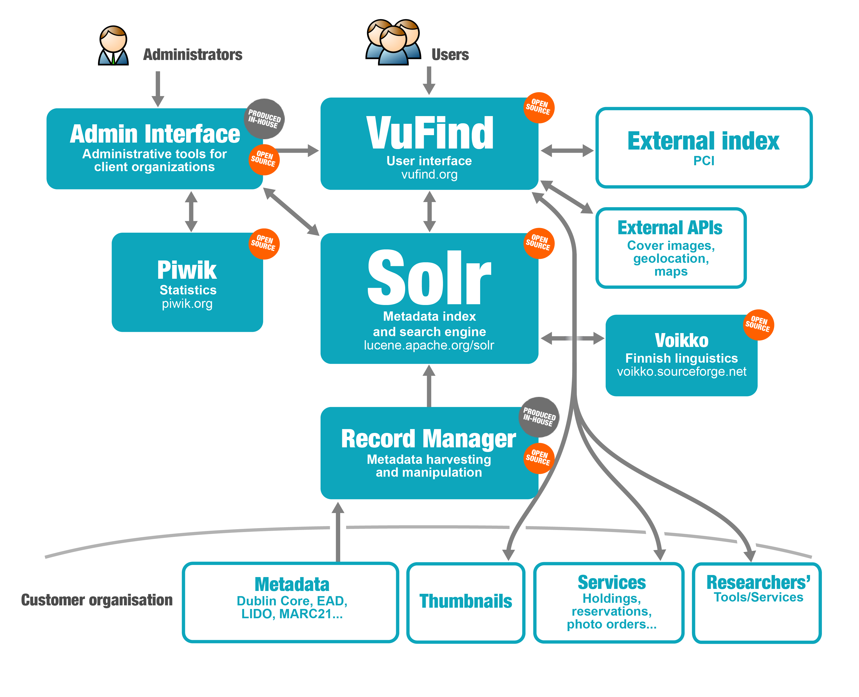
Architecture Overview

Slide 4
What’s Fault Tolerance and Load Balancing About
Fault tolerance in this case means that the loss of a front-end server causes (mostly) no problems that end-users would see
Depending on load balancer configuration some transiest request failures may occur
Load balancing allows to use a few smaller servers instead of a big one and makes it easier to scale further
Can be implemented in different ways
Here each server includes all services critical to VuFind
No sticky sessions
Requests and thus user sessions not bound to a single server

Slide 5
Main Software Components
VuFind
MariaDB with Galera Cluster
Solr 5 with SolrCloud
Shibboleth Service Provider
Red Hat Satellite

Slide 6
Hardware Architecture
A hardware load balancer
In our case Cisco ACE
Software based solutions such as HAproxy also possible, probably also more versatile (but one more server adds a single point of failure)
VMWare cluster for servers
3 front-end servers each running VuFind, MariaDB and Solr

Slide 7
Additional Hardware
Try to handle other load on separate servers to keep load on each front-end server as symmetric as possible
1 back-end server handling harvesting and indexing
Keep load on each front end server in balance
1 front-end staging server
1 front-end and 1 back-end development server
For Piwik 1 primary server and 1 hot standby server using MariaDB master-slave replication

Slide 8
Load Balancer
Set up to distribute requests randomly between servers
Uses VuFind’s /AJAX/SystemStatus service to check server health
Set up to use X-Forwarded-For header in requests to front-end servers
Service’s DNS entry points to the load balancer

Slide 9
VuFind and Apache
Identical installations on each front-end server
mod_rpaf used in Apache to map IP address from X-Forwarded-For to normal Apache fields
No special logic needed in other software components
VuFind set up to fall back to another Solr instance if the local one is down
VuFind’s /AJAX/SystemStatus set up to use a health check file that can be used to drop the server from load balancer
Scheduled tasks like cleaning up of expired searches done on one front-end
AlphaBrowse indexing needs to run on all servers

Slide 10
MariaDB Galera Cluster
One node on each server providing a cluster
Each VuFind connects to the local MariaDB node
Percona XtraBackup used for online backups
Non-blocking backups
Needs TCP ports 3306 4444 4567 and 4568

Slide 11
SolrCloud
Currently a basic three node installation
One node on each front-end server
No shards, just replicas for now
Each replica will probably be split into two shards in the future
External Zookeeper nodes on each server
Updates are automatically distributed to all nodes
No need for the harvesting/indexing service to be aware of SolrCloud provided it uses HTTP
Solr needs TCP port 8983 by default (8080 in VuFind’s)
Zookeeper needs TCP ports 2181, 2888 and 3888

Slide 12
Shibboleth
Use ODBC for storage
Data stored in the MariaDB cluster
State available on each server so no sticky sessions required
Needed to tweak configuration with VuFind 1 so that performance didn’t suffer with high server loads
<DirectoryMatch "/data/finna">
Options FollowSymLinks
AllowOverride All
Order allow,deny
Allow from all
# AuthType shibboleth
# require shibboleth
</DirectoryMatch>
<FilesMatch "index.php">
AuthType shibboleth
require shibboleth
</FilesMatch>

Slide 13
Red Hat Satellite
Configuration file management
Package management
Can be used to execute commands
On an external server
A bit clumsy at times
E.g. Puppet is also a popular choice

Slide 14
Benefits
Fault-tolerance
One or even two of three front-end servers can be down without affecting end user experience (apart from possible performance issues)
Load-balancing and scalability
It’s typically less expensive to add servers than to increase their capacity
Rolling upgrades (no downtime)
E.g. restarting Solr on one server can be done without interrupting the service

Slide 15
Downsides
Caches are local to each server, so e.g. hierarchy trees must be built on each server
Shared disk or cache in database?
AlphaBrowse indexes must be available on all servers
Generate in all or distribute from one to the others
AlphaBrowse won’t work with a sharded Solr index
Solr’s MoreLikeThis query handler doesn’t work with distributed (sharded) indexes
Need to investigate the new MLT handler that’s feature complete in Solr 5.3
Piwik doesn’t work well in a load-balanced environment
On its own server
Could maybe use QueuedTracking with Redis Cluster

Slide 16
Pitfalls
Static file modification times
Need to be the same on all servers or caching won’t work
ETag
A simple hash identifying a file
Default Apache configuration will break caching
Alternative Apache configuration: FileETag MTime Size
SolrCloud distributes queries randomly unless preferLocalShards is true
MariaDB cluster needs to be manually started if all nodes go down
unixODBC used with Shibboleth crashes regularly on RHEL 6 servers
Needs newer unixODBC I had to roll into a package myself

Slide 17
Possible Next Steps
Sharding of the index
Couple each front-end server with an index server and split the index into two shards
Keep it manual so that each couple can be updated and rebooted without affecting others
Requires the new MoreLikeThis handler
More memory or SSD on the servers
At some point it will become impractical to add memory
SSD might help
Mess with garbage collection settings
Uhh…
Smarter load balancers?

Slide 18
Links
SolrCloud: https://cwiki.apache.org/confluence/display/solr/SolrCloud
Our Solr package: https://github.com/NatLibFi/NDL-VuFind-Solr
MariaDB Galera Cluster: https://mariadb.com/kb/en/mariadb/getting-started-with-mariadb-galera-cluster/
VuFind fault-tolerance page: https://vufind.org/wiki/vufind2:fault_tolerance_and_load_balancing
unixODBC on RHEL 6: https://github.com/EreMaijala/unixODBC

Slide 19
Not bad, huh?
Ere Maijala
ere.maijala@helsinki.fi

