Slide 2
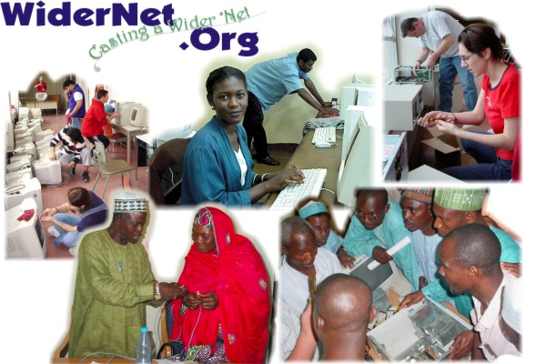

Slide 3


A service program of SILS that conducts research and development into solutions for underserved communities, including the continued development of the eGranary Digital Library. Provides multi-modal training to library and information professionals worldwide, prototypes innovative hardware and software solutions, and disseminates research into best practices for global information access.
A non-profit organization that manufactures and distributes the eGranary Digital Library and provides training and computer labs for subscribers.

Slide 4

Internet

Slide 5


Slide 6
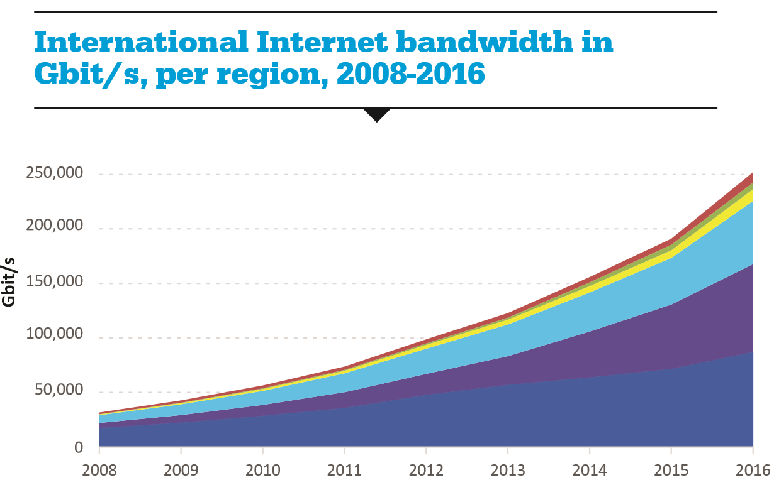
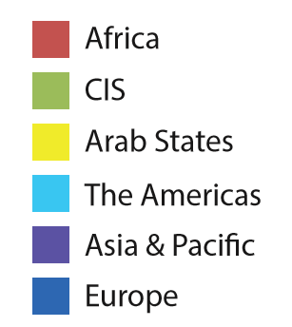

Slide 7
System Reliability
Internet outages can go on for weeks
Electricity can go out several times a day
2013 study: Only 34% of hospitals had reliable electricity in sub-Saharan Africa
Few people have experienced truly functional systems
“Wants desperately to make things work in spite of all the people who are supposed to make it work.”

Slide 8
It’s Not Just a Lack of Internet
Basic needs have yet to be met
Schools lack books
Communities lack libraries
Reading culture undeveloped
Connected experts disconnected

Slide 9
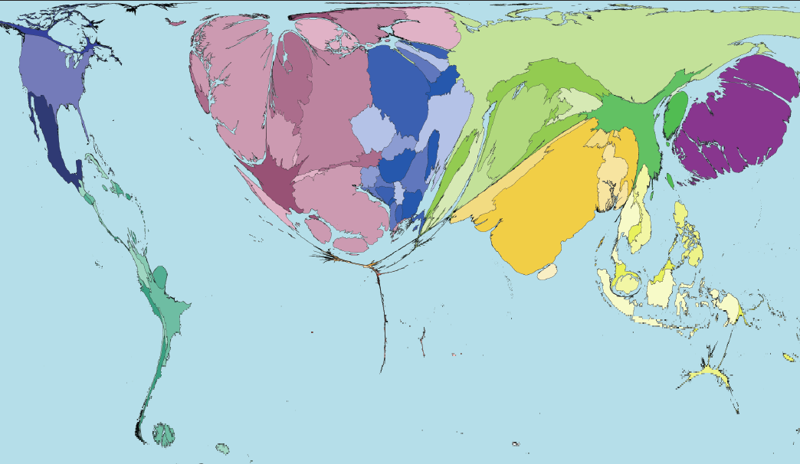
Books Borrowed Worldwide

Slide 10
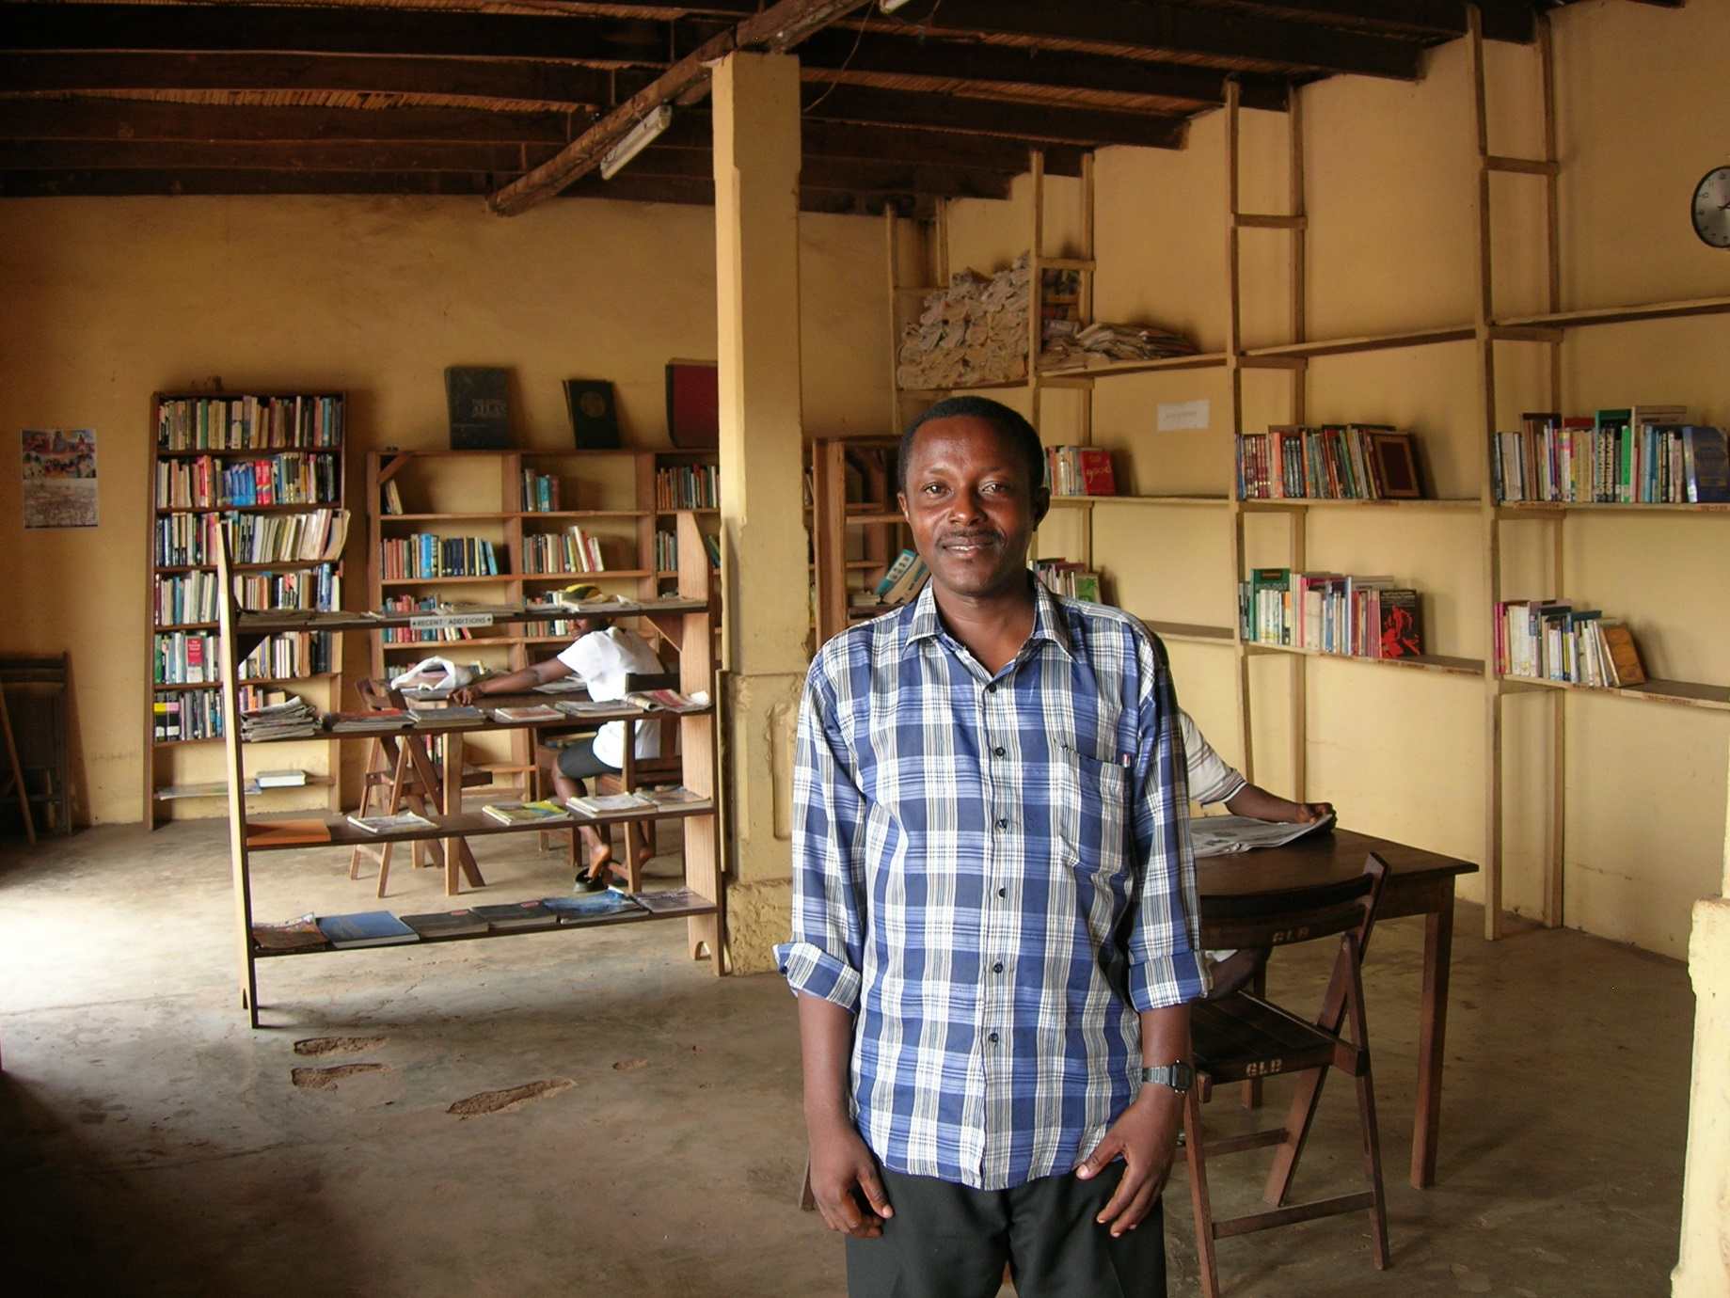

Slide 11
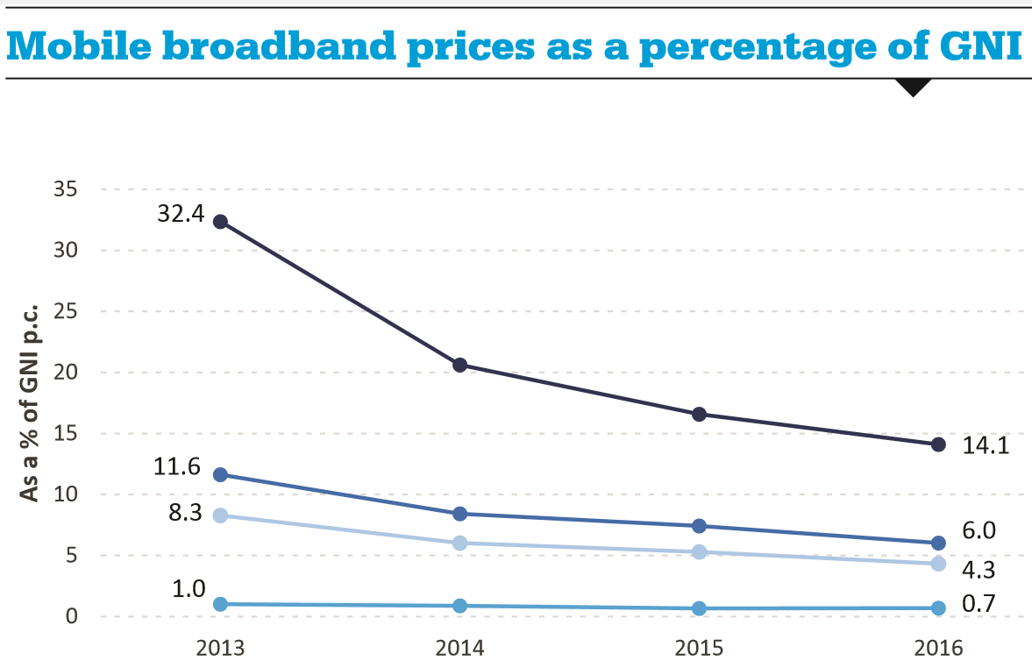
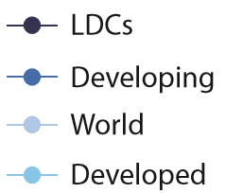

Slide 12
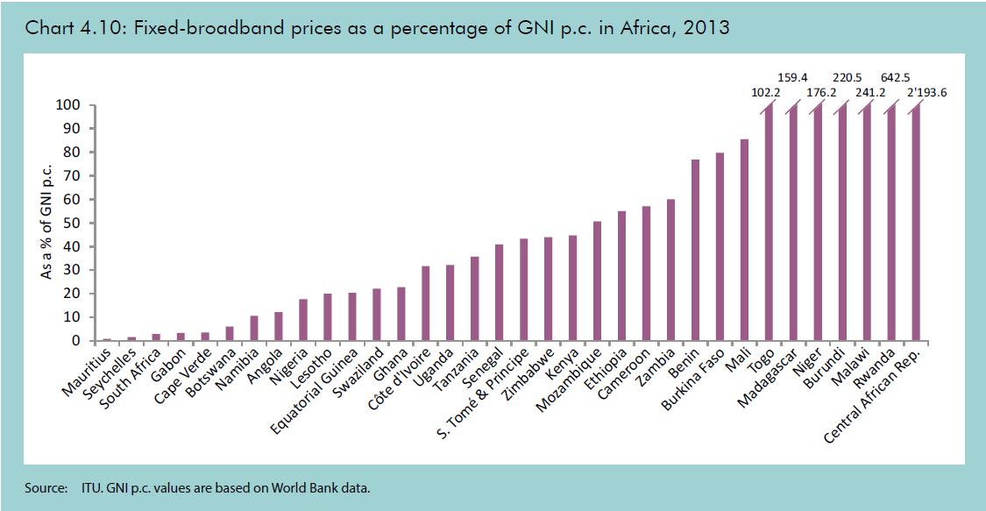

Slide 13
The eGranary Digital Library
“The Internet in a Box”™

Slide 14
Replacing Bandwidth with Storewidth
Information stored inside LAN
Millions of educational documents
Collection created and maintained by librarians
Multimedia, audio, video at full network speeds
No bandwidth costs
Augments a conventional Internet connection (hybrid)
← Internet
LAN →

Slide 15
Underlying eGranary Concepts
Information cache
Bandwidth conservation
Off-line information store
Edge technology
“The Internet in a Box”

Slide 16

The eGranary Digital Library can provide thousands of networked computers high-speed access to millions of documents and multimedia files over a local area network.
Even when the Internet connection is broken!
X
LAN
← Internet
Notes:
The eGranary Digital Library.
Presented June 6, 2005
Cliff Missen -- The Widernet Project
16

Slide 17
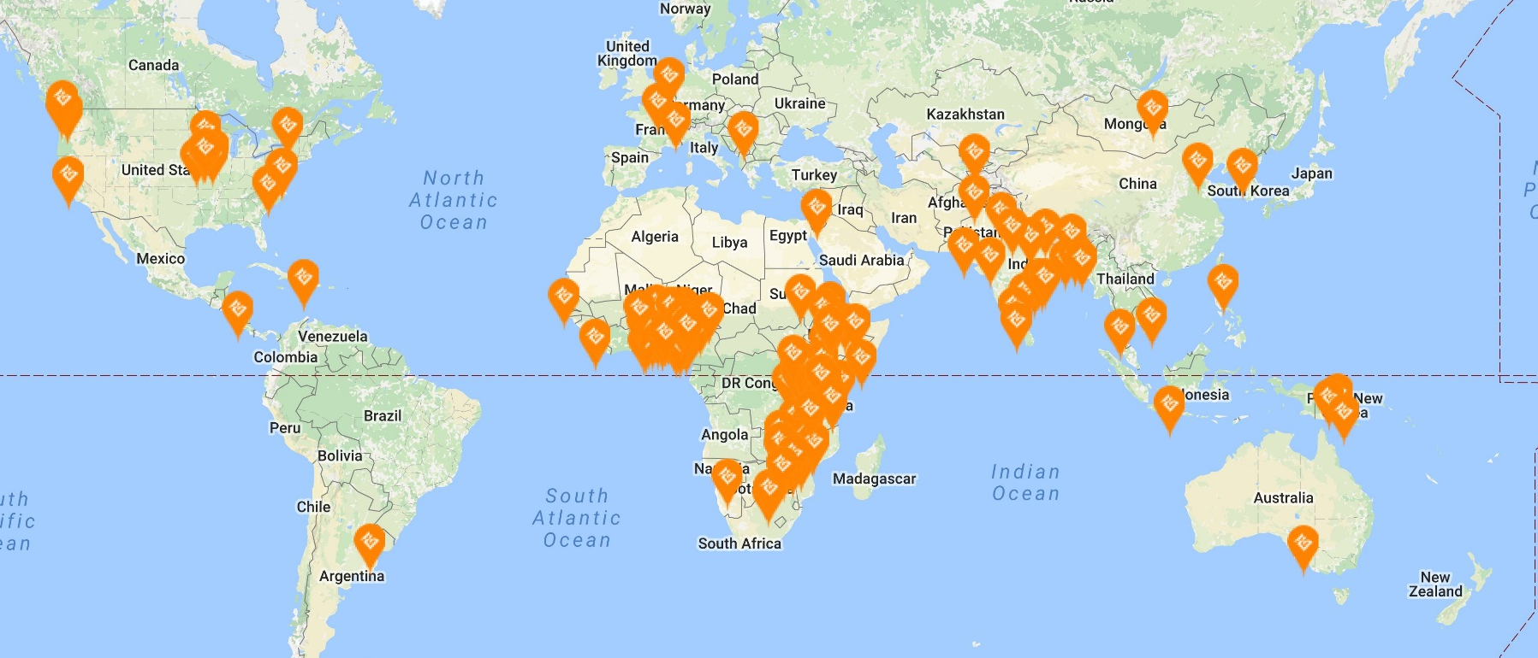
The eGranary Digital Library
6TB drive
Latest “big grabs”: TED Talks, World Bank
Over 2,000 installs

Slide 18
The eGranary Digital Library
Permission from over 2,400 authors & publishers (MIT OpenCourseware, Wikipedia, WHO, Math TV, Virtual Hospital, Khan Academy, etc.)
Over 35 million documents
50,000+ books, hundreds of journals, hundreds of Web sites & CDs
Patrons open documents 100 – 5,000 times faster than with their Internet connection
Built-in search engine and catalog. Looks and acts just like the Internet.

Slide 19
Community Information Platform
CIP adds interactive “Web 2.0” capabilities
  Create IDs and logins (LDAP security)
  Built-in software for making unlimited Web sites
Easy to upload and share locally-made content
Local content can be centrally developed and shared to other eGranary sites
  MySQL and PHP for local dynamic Web databases
    Moodle: course management software
    WordPress: Web content management system
Notes:
The Community Information Platform, or CIP, is a new addition to the eGranary Digital Library. The previous edition of the eGranary only allowed users to view information that had been pre-installed. With the CIP, each eGranary is interactive: it allows users to create and edit their own content to add to their eGranary. The Community Information Platform, sponsored by Intel, includes a host of Web 2.0 technologies, like built-in Web editors, LDAP security, Moodle, MySQL, PHP, Drupal and others. Subscribers can set up unlimited Web sites on their server and use free, built-in software to make Web pages, upload files and share local information with each other.
Using a simple interface, users can create Web sites that are stored in their local eGranary. The interface makes it easy to upload files, like photos, slideshows and documents. Your Web page or site can be about anything you want. Examples of the type of content you might want to create using the CIP are:
a page or site for a community club or group;
a community directory;
a Web site for a school, library, hospital or other community organization;
a course Web site;
a personal Web page about yourself or your family, with information and photos;
social networking sites.
Creating Web pages on the Community Information Platform is easy. The built in Web editing software contains pre-configured settings and themes that can be used for the creation of new Web pages. With these built in, ready to use features, you can create a fully functioning Web page or site by simply adding the information you wish to appear on your Web page to a pre-configured template.
The built in software allows editors to add and edit content. The eGranary manager can create an unlimited number of Web sites that can be viewed by anyone within the community. Users can only alter their own Web sites, not the original eGranary content or the sites of other users.

Slide 20
Street Cred
80% of new installs are repeat business
Accreditation
  Texas Prisons
    Six prisons to date. More in the pipeline.
  Nigerian Universities Commission
    80 public universities and colleges
Papua New Guinea
  15 teachers colleges
  Local telecomm provider

Slide 21
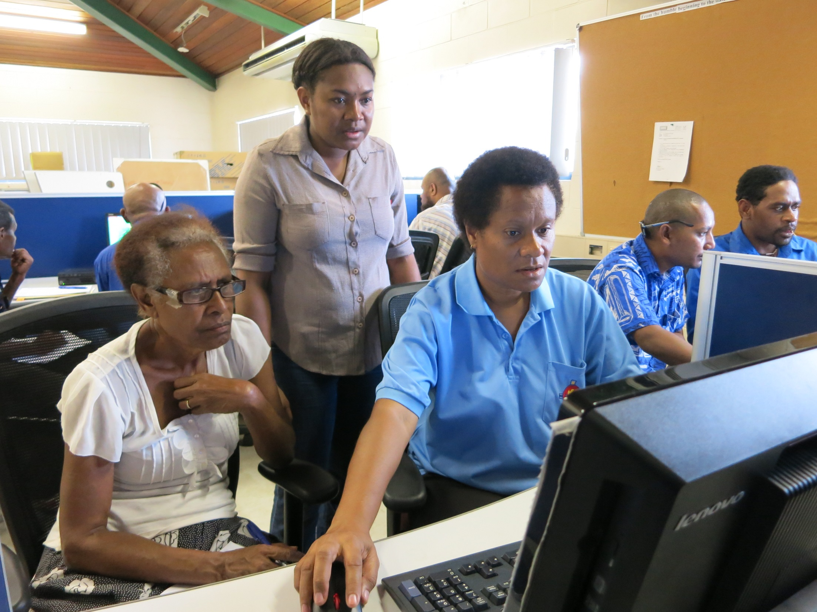

Slide 22

User-Friendly Portals
Having access to information is one thing, being able to use it well to meet a specific purpose is another
Portals organize information into user-friendly, issue-centric interfaces
  Health care, education, water development, etc.
Reduces the time and effort for new users to integrate digital resources into their mission

Slide 23

Solidarity Librarianship
Area librarianship for groups of people with similar needs/goals
One half of good service is simply listening
Wisdom of the crowd
Reduces the time and effort for new users to integrate digital resources into their mission

Slide 24
The eGranary Stack
Apache
Lucene
SOLR
VUFind

Slide 25
Accommodating Local Content
Indexing added content
Integrating local catalog records
? Open Source ILS ?

Slide 26
Getting Small
Scaling to a billion
Smartphones, tablets, laptops, thumb drives, etc.
Locally built and managed collections (secondary schools, rural medicine, regional languages, etc.)
Going to the library to check out a library

Slide 27
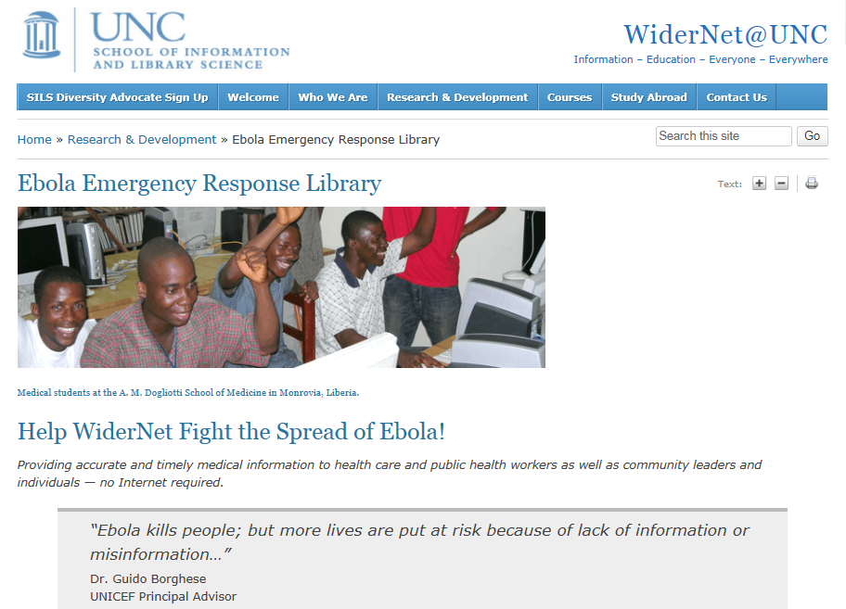

Slide 28
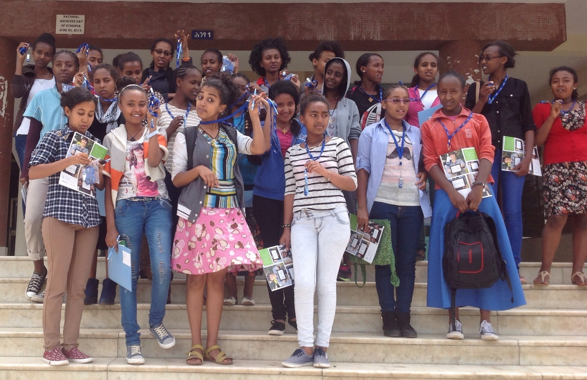
Ethiopia: “Girls Can Code”

Slide 29
eGranary Feature Set Map
USER APPS
Email
Instant messaging
Community boards
Web sites / dev tools
File storage
CONTENT APPS
Catalog editor
Portal development
School management
Local content indexing
OPTIONAL SERVICES
SMS Server
SIP Server
Mesh network controller
OpenMaps
SERVER MANAGER APPS
cPanel to provision services
Logs / reporting
Troubleshooting
LMS
Search
Quarantine
WebDav
Catalog
LDAP Security
SQL Database
Web Server
Internet Manager
Operating System

Slide 30
eGranary with Content Silos
Web Content
Web Content
Software
Software
Catalog
Catalog
Index
Index
Data
Data
LMS
Search
Quarantine
WebDav
Catalog
LDAP Security
SQL Database
Web Server
Internet Manager
Operating System

Slide 31
Silos Offer Flexibility
Anyone can make a silo
Silos can be made for specific groups or topics
Ideal for government/NGO documents or local languages
Silos can be created and updated centrally, then distributed via DVD or USB key

Slide 32
Silos in the eGranary
eGranary
Local
Others
Web Content
Web Content
Web Content
Software
Software
Software
Catalog
Catalog
Catalog
Index
Index
Index
Data
Data
Data

Slide 33
New Silos Snap-In / Snap-Out
Registered Silos
Web Content
Web Content
Software
Software
Catalog
Catalog
Index
Index
Data
Data

Slide 34
Silos Combine into Single View
eGranary
Local
Others
Web Content
Software
Catalog
Index
Data

Slide 35
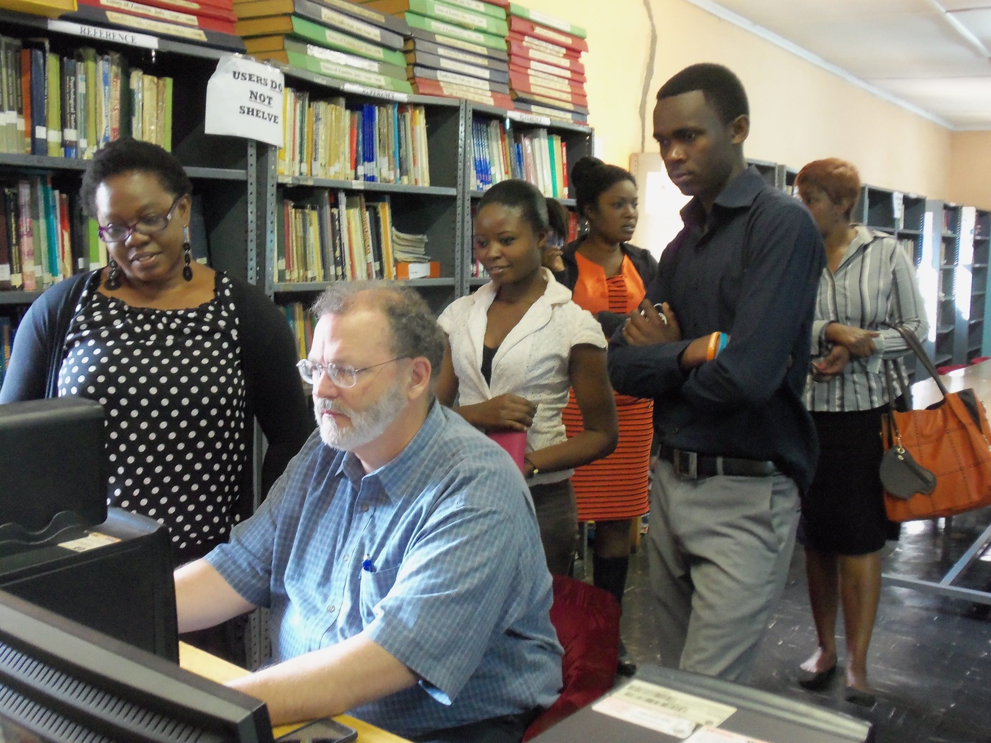

Slide 36
The eGranary Digital Library
WiderNet@UNC
The School of Information and Library Science
University of North Carolina, Chapel Hill http://www.egranary.org
Presenter: Cliff Missen missenc@widernet.org

