Slide 1
Installing DSpace 7.1 and integrating with VuFind 8.0.1
Experiences and challenges
M.Jayakananthan
Research Data Librarian
International Water Management Institute, Sri Lanka
VuFind Summit 2021, 15-17 November 2021

Slide 2
Front End
DSpace 7 is the largest release in the history.
Frontend (UI) is a Bootstrap designer
Back End
Backend is now one webapp
Security & Stability are Priority
Database
Upgrade from DSpace older versions

Slide 3
Release 8.0.1
Import data directly to VuFind from CSV files
Significant improvements for internal handling of MARC records and search result
Citation generation
Further improvements in PHP Solr OAI-PMH

Slide 4
Objectives
Look into the main features of the DSpace installation
Identify the challenges in the DSpace installation and configuration
Enable OAI-PMH in DSpace and integration with VuFind
Automate the harvesting and indexing process

Slide 5
Methodology
Dspace 7.1
Backend
Frontend
VuFind 8.0.1
Installation
OAI-PMH
Union Interface
Harvesting
Indexing
Automate the process
Auto Script
Cron Job

Slide 6
Installing Dspace 7.1 Backend
Essential requirements for Backend to run
UNIX-like OS or Microsoft Windows
Java JDK 11
Apache Maven 3.3.x
Apache Ant 1.10.x
PostgreSQL 11.x, 12.x or 13.x
Apache Solr 8.x
Servlet Engine (Apache Tomcat 9
Git

Slide 7
Installing Dspace 7.1 Backend
Update your system
sudo apt update
sudo apt upgrade –y
Install Java OpenJDK 11
sudo apt install openjdk-11-jdk
If you have previously installed another version of JAVA, change the default java to newly installed version.
sudo update-alternatives --config java

Slide 8
Installing Dspace 7.1 Backend
Install Apache Maven and Ant
sudo apt-get install ant ant-optional maven –y

Slide 9
Installing Dspace 7.1 Backend
Install PostgreSQL v11 database
By default, PostgreSQL is not available to install directly from the Debian 11 base repository. Now we add the official PostgreSQL repository to your system:
Add the PostgreSQL 11 APT repository
Type the command “lsb_release -a” and press enter.
Note your Codename and add following repository to your system
wget --quiet -O - https://www.postgresql.org/media/keys/ACCC4CF8.asc | sudo apt-key add –
echo "deb http://apt.postgresql.org/pub/repos/apt/ focal"-pgdg main | sudo tee /etc/apt/sources.list.d/pgdg.list
sudo apt update
sudo apt-get install postgresql-11 postgresql-contrib-11 libpostgresql-jdbc-java -y

Slide 10
Installing Dspace 7.1 Backend
Install PostgreSQL v11 database cont.………
Allow the database user to connect to the database.
Open the file "pg_hba.conf" by using the following command.
If the following command not open, check the postgresql version number and apply in the command.
sudo nano /etc/postgresql/11/main/pg_hba.conf
Then tighten up security a bit by editing pg_hba.conf and adding this line:
host dspace dspace 127.0.0.1 255.255.255.255 md5
you need to enable TCP/IP connections (DSpace uses JDBC)
In postgresql.conf: uncomment the line starting: listen_addresses = 'localhost'.

Slide 11
Installing Dspace 7.1 Backend
Install PostgreSQL v11 database cont.………
Setup the PostgreSQL server host-based access permissions by editing the "pg_hba.conf" file.
sudo sed -i 's/ident/trust/' /etc/postgresql/11/main/pg_hba.conf
sudo sed -i 's/md5/trust/' /etc/postgresql/11/main/pg_hba.conf
sudo sed -i 's/peer/trust/' /etc/postgresql/11/main/pg_hba.conf
Restart the PostgreSQL database for these changes to take effect.
sudo systemctl restart postgresql

Slide 12
Installing Dspace 7.1 Backend
Now, we must construct the dspace user of the dspace database as well as the database itself. Go to the PostgreSQL system user first.
sudo su postgres
PostgreSQL provides a default system user by name when you install the database. Then run the following command to create the database user dspace.
createuser dspace
createdb dspace -E UNICODE
This will construct a Unicode-encoded database called "dspace.“
Next, we need to give the database user dspace access to call the database we just built, also known as dspace. With the following single command, you can access the database shell and use the dspace database.
psql -d dspace

Slide 13
Installing Dspace 7.1 Backend
Setup PostgreSQL dspace DB user password, ownership and privileges.
ALTER ROLE dspace WITH PASSWORD 'your-db-password-here’;
Use your unique dspace database password for this on a production system.
Let the dspace DB user own the dspace database
ALTER DATABASE dspace OWNER TO dspace;
Grant all privileges for the dspace database to the dspace DB user
GRANT ALL PRIVILEGES ON DATABASE dspace TO dspace;
Add the "crypto" extension to the "dspace" database.
CREATE EXTENSION pgcrypto;
Quit the database shell. \q
exit from PostgreSQL. Exit
Restart PostgreSQL with the following command : sudo systemctl restart postgresql

Slide 14
Installing Dspace 7.1 Backend
Install Apache Solr
Create a directory to download and install solr
sudo mkdir /opt/solr-8
cd /opt/solr-8
Change directory owner to dspace user
sudo chown -R dspace: dspace /opt/solr-8
Then download solr-8 from there with the following command. And extract then move to the solr folder.
wget -c https://downloads.apache.org/lucene/solr/8.10.1/solr-8.10.1.tgz
tar xvf solr-8.10.1.tgz
cp –r /opt/solr-8/solr-8.10.1/* / opt/solr-8 /
Start the solr: /opt/solr-8/bin/solr start -force

Slide 15
Installing Dspace 7.1 Backend
Install Apache Solr cont.……
If you access http://:localhost:8983/solr in your browser, the solr admin panel should load.

Slide 16
Installing Dspace 7.1 Backend
Install tomcat 9.0.54 servlet
Create folder tomcat under /opt
sudo mkdir /opt/tomcat
Create tomcat user
sudo useradd -m -U -d /opt/tomcat -s /bin/false tomcat
Download tomcat
wget -c https://dlcdn.apache.org/tomcat/tomcat-9/v9.0.54/bin/apache-tomcat-9.0.54.tar.gz
Extract the downloaded tomcat
sudo tar xzvf apache-tomcat-9.0.54.tar.gz
The Tomcat owner must have read/write access to the DSpace installation directory.
chown -R tomcat:tomcat /home/dspace7

Slide 17
Installing Dspace 7.1 Backend
Install tomcat 9.0.54 servlet
Need to modify or override the "tomcat.service" file.

Slide 18
Installing Dspace 7.1 Backend
Install tomcat 9.0.54 servlet
Modifications in [tomcat]/conf/server.xml
<!-- Define a non-SSL HTTP/1.1 Connector on port 8080 -->
<Connector port="8080"
minSpareThreads="25"
enableLookups="false"
redirectPort="8443"
connectionTimeout="20000"
disableUploadTimeout="true"
URIEncoding="UTF-8"/>

Slide 19
Installing Dspace 7.1 Backend
Install tomcat 9.0.54 servlet
Start the tomcat service
cd /etc/systemd/system
sudo systemctl daemon-reload
sudo systemctl start tomcat
sudo systemctl status tomcat

Slide 20
Installing Dspace 7.1 Backend
Install tomcat 9.0.54 servlet
Chek tomat on web browser
http: // localhost: 8080

Slide 21
Installing Dspace 7.1 Backend
Install Git
For the latest stable version
apt-get install git
Download latest version of Dspace release
https://github.com/DSpace/DSpace/releases
https://github.com/DSpace/DSpace/archive/refs/tags/dspace-7.1.zip
wget https://github.com/DSpace/DSpace/archive/refs/tags/dspace-7.1.zip
Extract and move to the Dspace-7 folder.
Dspace source file loation- [dspace-source]: /Dspace-7
Dspace installation file location - [dspace]: /home/dspace-7
unzip dspace-7.1.zip
mv DSpace-dspace-7.1 dspace-7

Slide 22
Installing Dspace 7.1 Backend
Install backend
Create the installation directory
sudo mkdir /home/dspace-7
Set permissions for the dspace user to the installation directory
sudo chown dspace:dspace -R home/dspace-7
Create a local.cfg configuration file by copying the existing sample file.
cp dspace/config/local.cfg.EXAMPLE dspace/config/local.cfg
Edit the file and set some common required settings, such as the database connection and the installation directory.
dspace.dir=/home/dspace-7
solr.server = http://localhost:8983/solr
db.url = jdbc:postgresql://localhost:5432/dspace
db.driver = org.postgresql.Driver
db.username = dspace
db.password = *****

Slide 23
Installing Dspace 7.1 Backend
Build DSpace
Move to dspace source directory
cd dspace-7
Make sure you are in the source code directory and then run the command
mvn package

Slide 24
Installing Dspace 7.1 Backend
Install DSpace
Apache ant is now used to install the compiled dspace code into the deployment directory, test if our code can connect to the database, and then create the necessary tables in the database for us. To do this, run these commands.
cd dspace/target/dspace-installer
ant fresh_install
If you are successful, you should see a result similar to the following.

Slide 25
Installing Dspace 7.1 Backend
Deploy the server web application
sudo cp -r /home/dspace-7/webapps/* /opt/tomcat/webapps
sudo chown -R tomcat:tomcat *
sudo systemctl restart tomcat
DSpace installation creates a set of four empty Solr cores already configured. Copy them from [to the place where your Solr instance will discover them.
cp -r /home/dspace-7/solr/* /opt/solr-8/server/solr/configsets
Restart the Solr
/opt/solr-8/bin/solr restart -force

Slide 26
Installing Dspace 7.1 Backend
Initialize your Database
/home/dspace-7/bin/dspace database migrate
Create an Administrator Account
/home/dspace-7/bin/dspace create-administrator

Slide 27
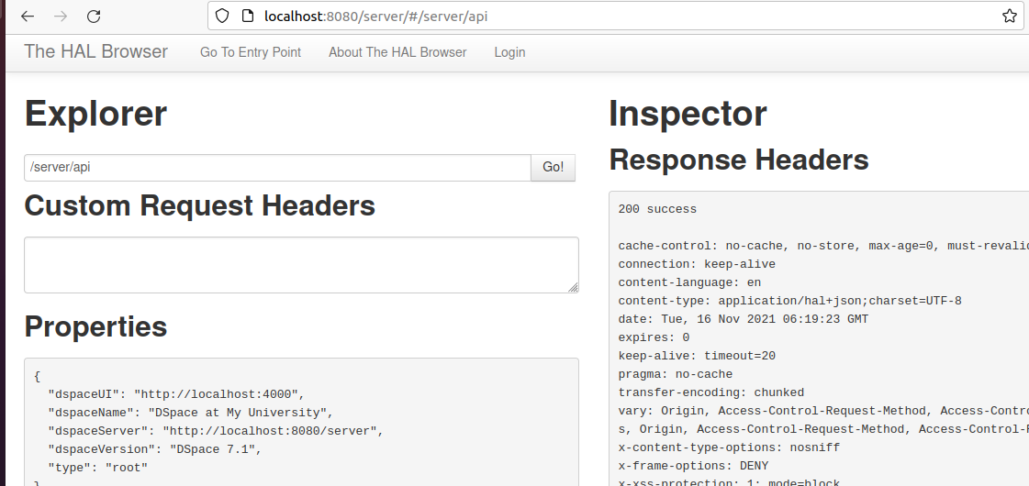
Installing Dspace 7.1 Backend
Then access http: // localhost: 8080 / server, you should be able to see the backend interface as shown below.

Slide 28
Installing Dspace 7.1 Frontend
Frontend Requirements
NVM installation
sudo apt install curl
curl https://raw.githubusercontent.com/creationix/nvm/master/install.sh | bash
source ~/.profile
Node installation using NVM
nvm install node
Install Yarn
curl -sS https://dl.yarnpkg.com/debian/pubkey.gpg | sudo apt-key add –
echo "deb https://dl.yarnpkg.com/debian/ stable main" | sudo tee /etc/apt/sources.list.d/yarn.list
sudo apt update
sudo apt install yarn

Slide 29
Installing Dspace 7.1 Frontend
Frontend Requirements
Instale NodeJS
Add the NodeSource PPA
curl -sL https://deb.nodesource.com/setup_14.x -o setup_14.sh
Let's make sure we are in the home directory and download the configuration script:
sudo sh ./setup_14.sh
sudo apt update
sudo apt install nodejs
PM2 (optional, but recommended for Production) npm install --global pm2

Slide 30
Installing Dspace 7.1 Frontend
Frontend Requirements
Download DSpace 7 front-end wget https://github.com/DSpace/dspace-angular/archive/refs/tags/dspace-7.1.zip
It will have a directory called dspace-angular-dspace-7.1 and rename this file to shorten the name then move into /home directory. mv dspace-angular-dspace-7.1 dspace-7-angular
Create a production configuration file at /home​​/dspace-7-angular/src/environments/environment.prod.ts. At a minimum, this file MUST include "ui" and "rest" sections similar to the following

Slide 31
Installing Dspace 7.1 Frontend
environment.prod.ts
export const environment = {
ui: {
ssl: false,
host: 'localhost',
port: 4000,
// NOTE: Space is capitalized because 'namespace' is a reserved string in TypeScript
nameSpace: '/'
},
rest: {
ssl: false,
host: 'localhost',
port: 8080,
// NOTE: Space is capitalized because 'namespace' is a reserved string in TypeScript
nameSpace: '/server'
}
};

Slide 32
Installing Dspace 7.1 Frontend
Frontend Requirements
Permission to dspace-angular directory. sudo chown dspace:dspace -R /home/dspace-7-angular
Move to /home/dspace-7-angular directory cd /home/dspace-7-angular
Build and run the front-end application yarn start

Slide 33
Installing Dspace 7.1 Frontend
create a JSON configuration file describing how to run our UI application.
{
"apps": [
{
"name": "dspace-angular",
"cwd": "/home/dspace-7-angular",
"script": "yarn",
"args": "run serve:ssr",
"interpreter": "none"
}
]
}

Slide 34
Installing Dspace 7.1 Frontend
Start the application using PM2 using the configuration file you created in the previous step pm2 start dspace-angular.json
pm2 stop dspace-angular.json

Slide 35
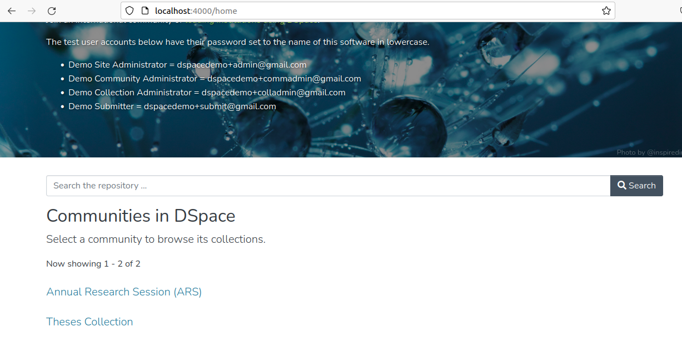
Installing Dspace 7.1 Frontend
Access the localhost:4000

Slide 36
Enable OAI-PMH
Go to Dspace installation {dspace}/bin and run the following command.
./dspace oai import -o –c

Slide 37
Enable OAI-PMH
Automate the OAI import process
nano crontab -e

Slide 38
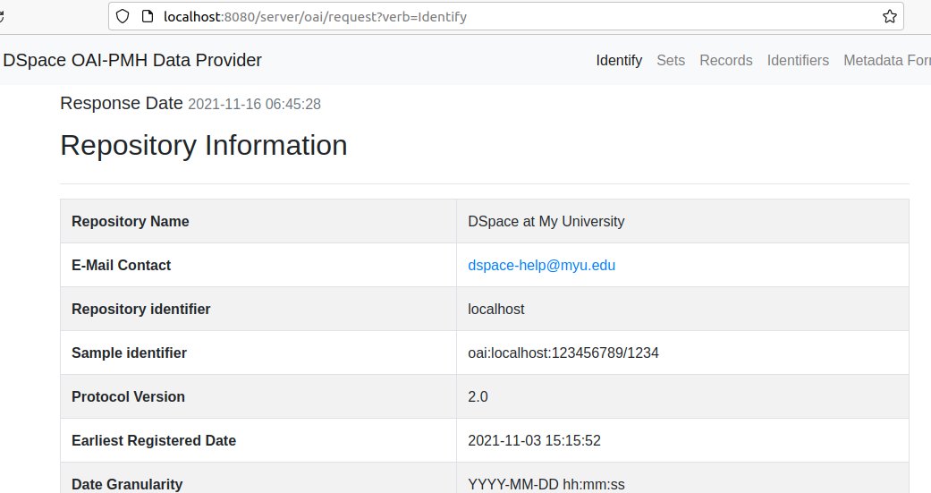
Enable OAI-PMH
Now access to Dspace OAI interface
http://localhost:8080/server/oai/request?verb=Identify

Slide 39
Enable Harvesting in VuFInd
Edit /usr/local/vufind/local/harvest/oai.ini as following:

Slide 40
Enable Harvesting in VuFInd
Manually harvest and indexing marc records into VuFind.
Run the following commands under $VUFIND_HOME/harvest
php harvest_oai.php
./batch-import-xsl.sh DSpace dspace.properties
Instead of using manual harvesting, auto incremental harvesting and indexing can also be done as given below:

Slide 41
Enable Harvesting in VuFInd

Slide 42
Enable Harvesting in VuFInd

Slide 43
Enable Harvesting in VuFInd

Slide 44
Enable Harvesting in VuFInd

Slide 45
Enable Harvesting in VuFInd

Slide 47
Conclusion
As a result of the above practice, we only need to add the records into the Dspace system. It is automatically harvested and added to the VuFind discovery interface.
Also, other library professionals can adopt this as practice and can build valuable services for their users.

Slide 48
Video full movie
Thanks

