Slide 1
Accessibility Testing for All
Katherine "Kate" Deibel, PhD Systems Librarian Philadelphia College of Osteopathic Medicine @metageeky / katheride@pcom.edu
This work is licensed under a Creative Commons Attribution-NonCommercial 4.0 International License.

Slide 2
Testing Accessibility: Yourself (1/2)
This talk cannot provide full accessibility training but here are the various methodologies that I utilize:
Free, automated single page testing tools such as Deque’s Axe, WebAIM’s WAVE, ANDI, and varied bookmarklets
Testing with various screen readers (NVDA) and browsers
Depending on how often pages change, sitewide testing tools like Monsido and SiteImprove may be run regularly
Manual testing for keyboard interactions and focus

Slide 3
Testing Accessibility: Yourself (2/2)
Accessibility testing is a lot of work:
Requires expertise, especially for screen reader testing
Best to split the work among many
Share your work with vendors and the larger community
But there is a test EVERYONE can do...

Slide 4
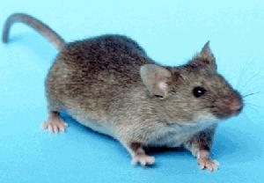
A mouse but then a cat appears…
Consider your mouse, touchpad, etc.
Imagine it's a real mouse…
… and you have a cat nearby

Slide 5
The cat chases the mouse
In other words…
YOUR MOUSE IS NO MORE!

Slide 6
How to test keyboard accessibility
Without the mouse, try to use the site using the keyboard:
Keyboard Key | What It Does
Tab | Move to next link, button, or form field
Shift + Tab | Move to previous link, button, etc.
Enter | Trigger current link or button
Space | Trigger interactive element (dropdown menus, buttons, checkboxes, etc.)
Up / Down | Navigate menus, choose radio buttons, adjust number inputs
Right / Left | Navigate menus, adjust sliders, etc.
Escape | Close menu or modal

Slide 7
Evaluating keyboard accessibility
Ask yourself:
Is it the same experience as using a mouse?
Can you navigate to everything on the page?
Can you manipulate everything?
Do you always know where you are?
Any hidden elements you can tab to?
Can you see those hidden elements?
Is the pattern of navigation smooth or chaotic?

Slide 8
A simple statement
This is keyboard accessibility.

Slide 9
Why Keyboard Accessibility Matters
When we think about web accessibility, we tend to focus on blind and low-vision users.
Physical impairments that impact mobility (fine and gross motor control) are more common:
Arthritis, Paralysis, Multiple Sclerosis, Lupus, ALS, Cerebral Palsy, Muscular Dystrophy, etc.
Prevalence of Types of Disabilities Ages 18-64 in the US (2013)
http://disabilitycompendium.org/

Slide 10
More Benefits of Keyboard Accessibility
Blind users and mice do not get along…
…even worse than blind mice and farmers' wives!
Keyboard accessible pages cooperate with screen readers!
And many weird folks like to mix it up between mouse and keyboard interactions (e.g., programming, data entry, etc.)

Slide 11
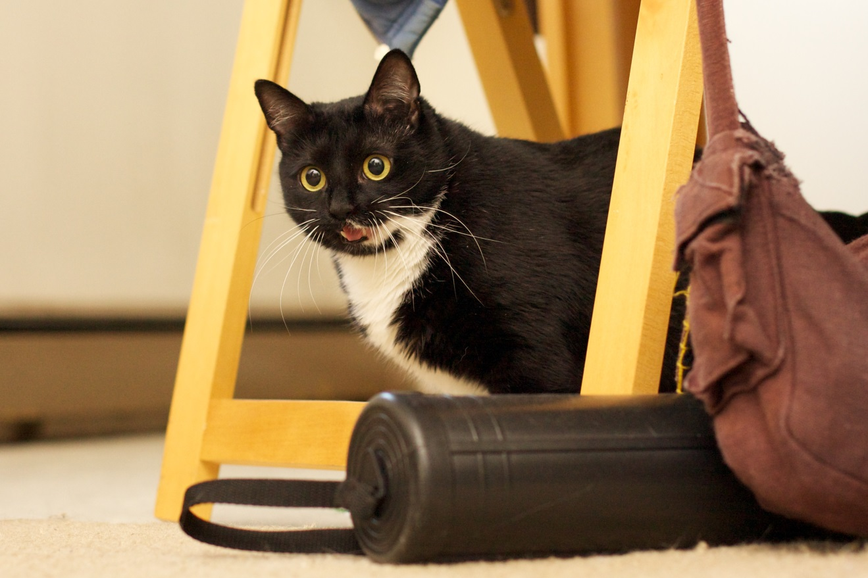
So remember...
NO MICE!!!
Francie (??? – 2020)

Slide 12
Web Accessibility Training
Attend workshops at conferences
Join the DLF Digital Accessibility Group: https://wiki.diglib.org/Digital_Accessibility_Group
Join the web-a11y slack space
Library Juice Courses by Carli Spina or Stephanie Rosen

