Slide 1
FOLIO Reporting with Help from VuFind®
Demian Katz
Director of Library Technology,
Falvey Memorial Library,
Villanova University
demian.katz@villanova.edu

Slide 2
Background
We migrated from Voyager to FOLIO in January, 2023.
Reporting is important to all library stakeholders.
Former solution: Microsoft Access + Voyager’s Oracle DB
Problems:
Slow, with little or no useful feedback
Terrible SQL editor
Difficult to install/configure, so not accessible to all staff
Benefits:
It worked, kind of

Slide 3
New Architecture
All data resides in a local PostgreSQL server.
Legacy data was migrated from Oracle to PostgreSQL using the ora_migrator plugin to db_migrator.
FOLIO data is loaded overnight using LDLite.
Queries are developed and executed using DBeaver.
Frequently used queries are published via a local custom VuFind® module.

Slide 4
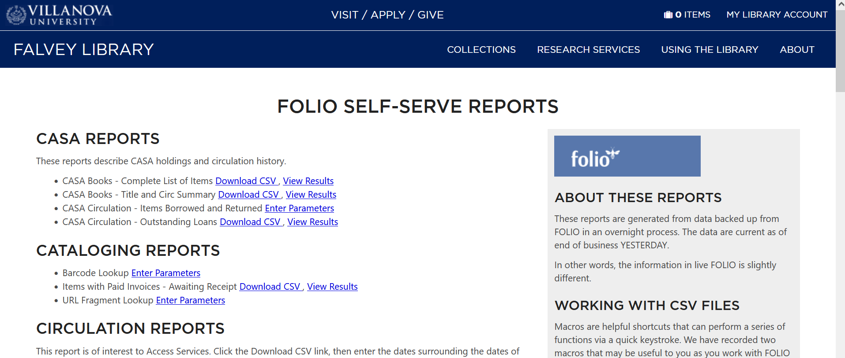
VillanovaReports Module

Slide 5
VillanovaReports Module
Features
Can connect to multiple databases
Can output to CSV download or display results on screen
Supports simple parameter input (form populates placeholders in query)
Has granular permission, so different users can be granted access to different queries

Slide 6
VillanovaReports Module
Architecture
Implemented as a stand-alone VuFind® module for security
Uses PDO to connect to the database
Reads a directory containing .sql + .ini pairs to populate menus
Leverages VuFind®’s native permission system
Things to do:
Add more robust parameter support
Improve efficiency of querying/output
Share the code (no current plans, but happy to do so if others have similar use cases)

Slide 7
Questions, Comments, Discussion
Contact Demian later: demian.katz@villanova.edu
@demiankatz on vufind.slack.com

