Slide 1
USING WORDPRESS FOR LIBRARIES
Goma Banjade
Library Officer
CAAN, Nepal
gbanjade76@gmail.Com
caanepal.gov.np/e-service/e-library
vufind.training.org
Notes:
This document is for the presentation in the webinar entitled “Digital Library Technology”. July 16, 2020

Slide 2
thoughts about librarians
“In the nonstop tsunami of global information, librarians provide us with floaties and teach us to swim.”
-Linton Weeks
(Washington Post Staff Writer, in Washington Post, Jan 13, 2001)
“If you want a future of libraries, it is within you, the librarians. If you want a healthy community that seeks out knowledge, and seeks informed conservation, then advocate for it beyond your walls.”
– R. David Lankes
(Prof. & Director of the School of LIS at the University of South Carolina)

Slide 3
Presentation outline
About WordPress
Why WordPress?
Why WordPress for Libraries?
WordPress Server Requirements for Version 5.2+
How to Install WordPress?
Front End & Back End
Dashboard
Plugins for Library Content Management
WordPress Course Content for Forth Coming Trainging
Objectctives of the Course

Slide 4
About WordPres
WordPress is a free and open-source content management system (CMS) written in PHP and paired with a MySQL or MariaDB database.
WordPress was released on May 27, 2003, by its founders, American developer Matt Mullenweg and English developer Mike Little, as a fork of b2/cafelog. The software is released under the GPLv2 (or later) license.
Source: https://wordpress.org/about/

Slide 5
…About WordPress
It is also the platform of choice for over 35% of all sites across the web.
Its latest version 5.4.3 (released in 6th July 2020)
The WordPress open source project has evolved in progressive ways over time — supported by skilled, enthusiastic developers, designers, scientists, bloggers, and more.
Source: https://wordpress.org/about/

Slide 6
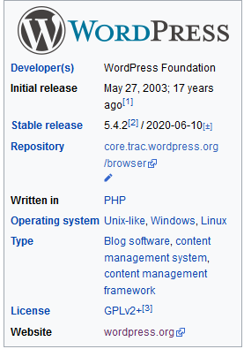
About WordPress
Source: https://en.wikipedia.org/wiki/WordPress
Notes:
Hs;jljggg

Slide 7
…About Wordpress
Source: https://www.ionos.com/digitalguide/hosting/cms/cms-comparison-a-review-of-the-best-platforms/

Slide 8
Why WordPress?
Free and open source software
It is easy to use and easy to customize.
It is flexible while designing a website
Robust security features
Search Engine Optimization (SEO) benefit – very good searching facility
Notes:
You can create your site as simple or as complex /in-depth as you like.
Representational state transfer (REST) - a software architectural style that defines a set of constraints to be used fo
r creating Web.
If you are a web developer, wordpress has REST API. It allows you to build apps using the platform.
Wordpress has a safe and secure platform. To be safe from malicious attacks, hackers, and malware, wordpress makes easy to enhance the security of your site with features like password protection for folder documents. It is easy to enable an SSL certificate for a wordpress site. Most of the time you can just get this from your web hosting service.

Slide 9
Why WordPress?
Simple content management
Application Programming Interfce (API)
Social Media Features
Optimized for Speed
Great support: abundance of guides, tutorials, and resources are online.
Notes:
You can create your site as simple or as complex /in-depth as you like.
Representational state transfer (REST) - a software architectural style that defines a set of constraints to be used fo
r creating Web.
If you are a web developer, wordpress has REST API. It allows you to build apps using the platform.
Wordpress has a safe and secure platform. To be safe from malicious attacks, hackers, and malware, wordpress makes easy to enhance the security of your site with features like password protection for folder documents. It is easy to enable an SSL certificate for a wordpress site. Most of the time you can just get this from your web hosting service.

Slide 10
Why WordPress?
It can create any type of website, for example:
An eCommerce website like eBay or Alibaba.
A Blog like Mashable or TechCrunch.
A Video Website like YouTube or Vimeo.
A Service/Appointment Booking Website.

Slide 11
Why WordPress?
It can create any type of website, for example:
A Photography Website like Flickr.com.
A Directory Website like YellowPages or Yelp.
A Classified Ads Listing Website like OLX.
A Membership Website like Udemy.
A Question Answer Forum like Quora.com.
A Knowledgebase/Wiki website.

Slide 12
Why WordPress for Libraries?
It is very easy content management system similar to Ms-Word or Word Processing program.
It lets one manage a library website more efficiently by separating the task of maintenance from the job of adding contents.
Administrative users can configure, customize and add features to the website, while editors and contributors can add, edit and manage their own contributions without worrying about the more technical aspects (Jones & Farrington, 2011)

Slide 13
Why WordPress for Libraries?
Multisites as well as multiusers facilities
Plugins like Koha Search and Vufind have been developed for WordPress
SubjectsPlus Shortcode for WordPress can be used for importing subject guide tools in WordPress. See https://github.com/little9/spshortcode
Security concerns and updates with latest version - easily handled.

Slide 14
WordPress Server Requirements for Version 5.2+
The recommended hardware requirements for running WordPress are:
Disk Space: 1GB+
Web Server: Apache or Nginx
Database: MySQL version 5.0.15 or greater or any version of MariaDB.
RAM: 512MB+
PHP: Version 7.3 or greater.
Processor: 1.0GHz+
Source: https://www.servermania.com/kb/articles/what-are-the-requirements-for-a-wordpress-server/

Slide 15
How to Install WordPress?
It is easy to install WordPress. It takes not more than 10 minutes. But Begin your installation by,
Checking to make sure your web host has the minimum requirements to run WordPress
Downloading the most current version
Unzipping the downloaded files
Creating a secure password
Keep the page open during installation
https://www.servermania.com/kb/articles/what-are-the-requirements-for-a-wordpress-server/
Notes:
https://ivanblagojevic.com/how-to-install-wordpress-on-windows-10-localhost/
https://ivanblagojevic.com/how-to-install-wordpress-on-windows-10-localhost/
How to install wordpress in windows 10 https://ivanblagojevic.com/how-to-install-wordpress-on-windows-10-localhost/

Slide 16
How to Install WordPress?
Download and unzip the WordPress package.
Create a database for WordPress on your web server.
Upload the WordPress files to the desired location of your web server.
Run the WordPress installation script by accessing your URL in any web browser
Source: https://www.servermania.com/kb/articles/what-are-the-requirements-for-a-wordpress-server/
Notes:
https://ivanblagojevic.com/how-to-install-wordpress-on-windows-10-localhost/
https://ivanblagojevic.com/how-to-install-wordpress-on-windows-10-localhost/
How to install wordpress in windows 10 https://ivanblagojevic.com/how-to-install-wordpress-on-windows-10-localhost/

Slide 17
Front End & Back End
Front-end refers to user interface. When users browse a website, he/she will notice the front end of the site. No login is required and no administrative functions can be performed.
Back-end refers the server, application and data work behind the scenes to present the information to the users. Backend is the administration area where authorized users can log in & manage site content.
WordPress Backend is also called a Dashboard and Admin panel. We can create, add or edit menus, posts, pages and the contents you required throgh the Dashboad.
Notes:
https://tutorialsclass.com/wordpress-frontend-backend/

Slide 18
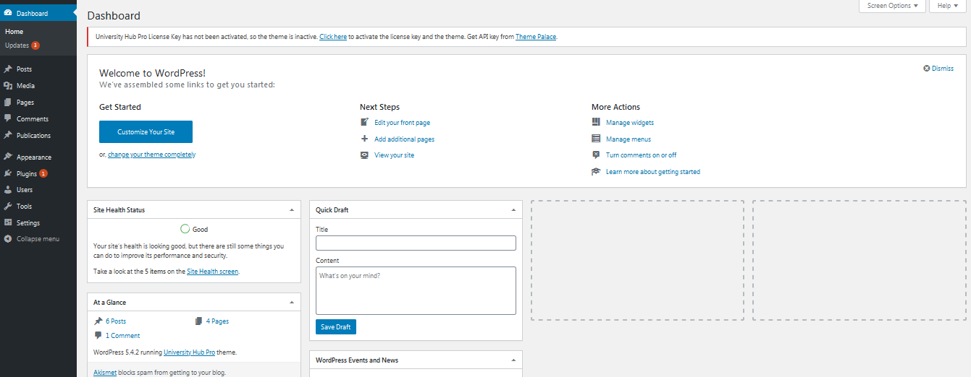
Dashboard

Slide 19
Plugins for Library Content Management
Library Management System
Koha Search Widget
Subjectsplus shortcode wordpress plugin
PhpMyBibliography (PMB) plugin for WordPress
Solr-search/VuFind for WordPress
Notes:
Solr-search = vufind search
Catablog is the wordpress plugin for online catalog.CataBlog is written, maintained, supported and documented by Zachary Segal. CataBlog is free software, and as such comes with absolutely no warranty or guarantee of service.

Slide 20
WordPress Course Content for Forth Coming Trainging
Module 1: Introduction & Installation
Introduction to WordPress
Benefits & drawbacks of WordPress
Installing WordPress in Ubuntu
Module 2: Anatomies of a WordPress Website
Common Architectures of WordPress Site
The wp-admin panel / Dashboard
Posts, pages, Categories and tags Comments
Themes
Plugins & widgets
Menus
RSS
Users

Slide 21
WordPress Course Content
Module 3: Working with Posts and Pages
WordPress Posts vs. Pages
Creating WordPress Posts
Editing, updating and deleting the post
Assigning the post with a specific category & Tags
Pages with featured images
Module 4: Working with WordPress Themes
How to find which WordPress theme a site is using
How to search a suitable theme for a website.
Customizing a theme

Slide 22
WordPress Course Content
Module 6: Extending Functionality of WordPress
Plugins
Plugins of Interest to Libraries
Security related plugins
Module 7: Multisite WordPress
Preparing WordPress
Allow multisite
Installing a network
Address of sites in your network
Enabling network
Admin setting

Slide 23
WordPress Course Content
Module 8: WordPress Security
Setting Secure File Permissions
Disabling Directory Views
Forbid Access to Sensitive Files
Remove the WordPress Version Number
Securing Your Database Secure Multiple Installations
Prevent Hotlinking

Slide 24
Objectctives of the Course
The course aims to enable participants to:
install WordPress in Linux OS
find and activate a suitable theme for their institution.
find and install plugins.

Slide 25
Objectctives of the Course
The course aims to them to:
create pages, posts and menu.
create featured images, pages and posts.
install multisites for a WordPress Site.
prepare a secured library website.

Slide 26
References
Haefele, C. (2015). WordPress for libraries.Lanham: Rowman & Littlefield
11 Reasons to Use WordPress For Your Website https://www.quicksprout.com/reasons-to-use-wordpress-for-your-website/
How to install WordPress in Detail https://wordpress.org/support/article/how-to-install-wordpress/#detailed-instructions
How to install WordPress on Ubuntu 20.04 with a LAMP Stack https://www.digitalocean.com/community/tutorials/how-to-install-wordpress-on-ubuntu-20-04-with-a-lamp-stack#step-1-—-creating-a-mysql-database-and-user-for-wordpress
Little9 / spshortcode https://github.com/little9/spshortcode
WordPress https://en.wikipedia.org/wiki/WordPress
Server Mania Hosting Empowered https://www.servermania.com/kb/articles/what-are-the-requirements-for-a-wordpress-server/

Slide 27
Thank you for joining the session!

