Slide 1
Automatic Mail configuration in Koha: Circulation Process
Webinar on Digital Library Software
May 26-28, 2021
Organized by
VuFind Software
M.Jayakananthan
Systems Analyst
Eastern University, Sri Lanka

Slide 2
Introduction
Most academic libraries now use the Koha ILS, and they naturally want to send email notifications to their patrons with circulation details, due date reminders, and overdue notices etc.

Slide 3
Exim Internet Mailer
Exim is a message transfer agent (MTA) created by the University of Cambridge for use on connected internet on Unix systems. The GNU General Public Licence allows it to be freely distributed.
The aim of this presentation is to assist library professionals in quickly setting up Exim email functionalities with Koha ILS .

Slide 4
Prerequisites
A server running Ubuntu.
A Fully Qualified Domain Name pointed at your Ubuntu.
Gmail account or other alternative official email services

Slide 5
Gmail configuration
For the purpose of sending notices from Koha, either use an existing Gmail account or build a new one.
It is better to create a fresh Gmail ID for the purpose.
In your Gmail account, allow less secure app access.

Slide 6
Less secure app access
Method 1
Login to your newly created account and open another tab navigate to https://myaccount.google.com/

Slide 7
Less secure app access
Click on Security

Slide 8
Less secure app access
Turn on Less Secure Apps Access

Slide 9
Less secure app access

Slide 10
Less secure app access
Gmail caused the SMTP service to stop working in nonTLS mode (on port 465); and For Gmail newly implemented method of authentication, we'll need an App password.

Slide 11
Less secure app access
Select 2-Step Verification >> Get started.
Follow the on-screen steps

Slide 14
Less secure app access

Slide 17
16-digit key (App password) you need to note down.

Slide 18
Less secure app access

Slide 19
Installing Exim
Exim is included in Ubuntu's default repositories and can be installed via APT.
To install exim4, use the following command
# sudo –i (to Enter with root permissions)
# apt-get update
# apt-get upgrade
# apt-get install exim4-base exim4-config exim4-daemon-light mailutils mutt
Issue the following command to start Exim configuration:
# sudo dpkg-reconfigure exim4-config
During the installation process, you will be presented with a set of interactive prompts. Fill in your prompts with the following details.

Slide 21
The networks on which your mail server is designed to transfer messages are listed here. For the most part, the default would suffice. If you do decide to change it, make sure to limit the network range as much as possible.

Slide 22
The mail destinations that this Exim instance will accept are described here. If you need to add any additional domains for which this server would be responsible, do so here. Otherwise, the default settings will sufficient.

Slide 27
Login Credentials
sudo nano /etc/exim4/passwd.client
Then, Add the following lines in the file. Save and close. smtp.gmail.com:your_username@gmail.com:password_here
Remember to replace the highlinghted text with your own Gmail ID and password in the above-mentioned line. For example,

Slide 28
Update configuration file and restart Exim
Apply the following commands. sudo update-exim4.conf
Restart Exim sudo service exim4 restart
Sending test mail from Exim
Apply the following command:
sudo echo 'My Test Text' | mail -s Testmail name@gmail.com
Replace name@gmail.com with your own real real Gmail ID.
Enable email messaging in Koha Apply the following command in a Terminal. sudo koha-email-enable library
Where ‘library’ is your instance in koha database.

Slide 29
Prepare Koha to send email messages
Setting up environment variables.
To run any of the Koha's programs from the Linux shell, PERL5LIB and KOHA_CONF have to be setup.
Koha's Perl programs look at these variables to determine the location of the installation's configuration file-koha-conf.xml and the location of the application folder i.e. instance.
Setting up PERL5 environment variable
The PERL5LIB environment variable points to the Koha's folder. To set up this, variable, the export command is used as follows:
#export PERL5LIB="/usr/share/koha/lib"
Testing can be done as follows to make sure the variable is set correctly.
#echo $PERL5LIB
it shows as follow:
/usr/share/koha/lib

Slide 30
Setting up KOHA_CONF environment variable
The KOHA_CONF environment variable should point to Koha's configuration directory. To setup this variable, export command is used as follows:
#export KOHA_CONF=“/etc/koha/sites/<instance name>/koha-conf.xml”
Testing can be done as follows to make sure the variable is set correctly:
#echo $KOHA_CONF
it shows as follow:
/etc/koha/sites/<instance name>/koha-conf.xml

Slide 31
Setting in Koha
Make necessary changes in Global System preferences: Koha Administration > Global System Preferences > Patrons > Enhancedmessagingpreferences >Allow
Global System preferences --> Patrons -->AutoEmailOpacUser--> Send
Global System preferences --> Patrons -->AutoEmailPrimaryAddress -->first valid

Slide 32
Setting in Koha
Make necessary changes in Global System preferences:
Global System preferences --> Administration --> KohaAdminEmailAdress, provide koha admin email id from which the email will be sent.

Slide 33
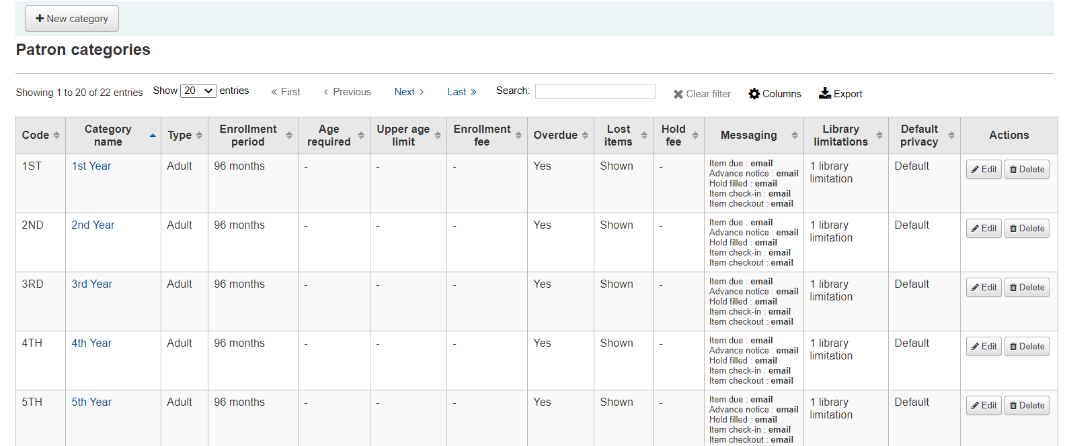
For each patron category, enable the email notice option. For this, go to:
Koha --> Administration --> Patron Categories --> Overdue Notice Required --> Yes

Slide 36
Set the Overdue Notice/Status Triggers
To do this go to :
Koha --> Tools --> Overdue Notice/status triggers.
Three notices can be sent as given below:

Slide 38
To customize the notices, go to Koha --> Tools --> Notices & Slips, as shown below:

Slide 40
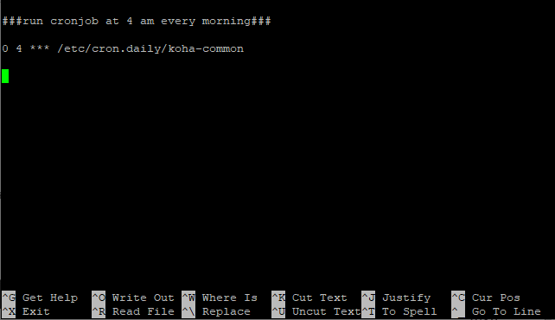
Cronjob has to be setup to activate the scripts as follows:
# cd /usr/share/koha/bin/cronjobs
# ./overdue_notices.pl
#./advance_notices.pl -c
# ./process_message_queue.pl
Setup a cronjob
# crontab -e
add the following line at the end of the file:
###run cronjob at 4 am every morning###
0 4 *** /etc/cron.daily/koha-common

Slide 41
Thank You

