Slide 1
Koha as z39.50 server
Parbati Pandey
Central Department of Library and Information Science
Tribhuvan University, Nepal

Slide 2
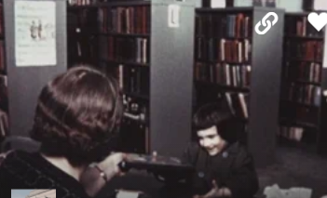
Introduction
A library catalog is a listing of all the items within a library where the bibliographic data are recorded in prescribed order and form.
Bibliographic data are managed in two ways :
Original catalogue
Copy catalogue

Slide 3
Copy catalogue
Copy catalogue is the act of importing needed bibliographic data from other library's server into your own server.
Z39.50 is a protocol for searching and retrieving bibliographic information from a database over a TCP/IP computer network.
SRU is roughly the XML version of a Z39.50 search. This will allow any Z39.50/SRU complaint client software to search and copy records from your catalog.
The procedures for configuring local computer to act as Z39.50/SRU server are given below:

Slide 4
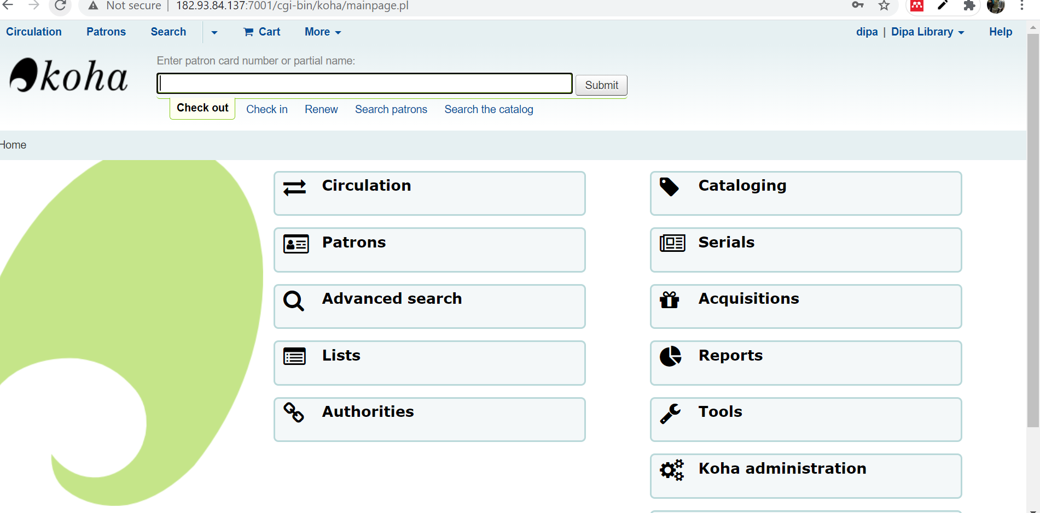
This instance is installed in Debian/ubuntu package
For configuring local computer to act as z39.50/SRU the following steps should be followed:

Slide 5
Steps for configuration Z39.50/SRU
Step1 : Enable library instance write the command:
# koha-z3950-responder --enable <instancename>

Slide 6
2nd step: Start the instance write the command :
# koha-z3950-responder --start <instancename>

Slide 7
3rd step : Setting configuration
Edit the file at /etc/koha/sites/<instancename)/koha-conf.xml

Slide 8
There are two places where comments have to be removed: one place is-
<!--
<listen id="publicserver" >tcp:@:</listen>
-->
Add <!– Public Server--> before <listen id="publicserver" >tcp:@:</listen> and delete -->

Slide 9
The @ symbol signifies IP addresses or domain name of your server system
Here ip 182.93.84.137 and port 9999 is used in this example) <listen id="publicserver" >tcp:182.93.84.137:9999</listen>

Slide 10
Another place where comments have to be removed is given below
<!-- PUBLICSERVER'S BIBLIOGRAPHIC RECORDS -->
<!–-[delete this one]
--------------------------
-------------------------
--> [delete this one]

Slide 11
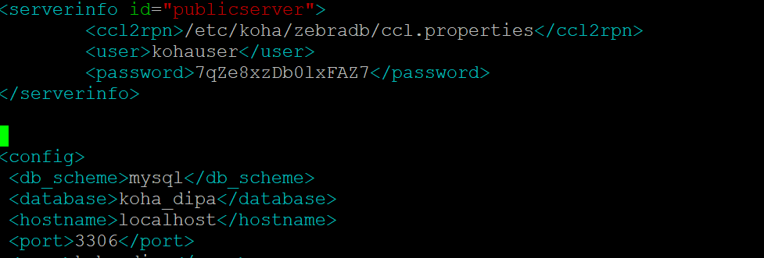

Slide 12
Step 4 : edit config.xml file using vim or other editor
/etc/koha/sites/<instance name>/z3950/config.xml

Slide 13
Go to line and change as follows :
<listen id="public">tcp:ip or domain name: port</listen>
Here ip is 182.93.84..137 and port is 9999

Slide 14
Restart service apache2 :
# service apache2 restart
Step 5 : Restarting the zebra server
Once the changes are done, first stop the zebra server and restart the zebra server as follows:
Stopping the zebserver:
#sudo koha-zebra --stop <instance>
# koha-z3950-responder --stop <instance>
Restarting the zebraserver:
# sudo koha-zebra --start <instance>
#koha-z3950-responder --start <instance>

Slide 15
The screen look like this:

Slide 16
Step 6 : After restarting zebra, telnet to the IP, using the command
#telnet 182.93.84.137 9999, it shows the following output, if successful:
Step 7 : YAZ client has also to be tested, if successful, it shows the following information

Slide 17
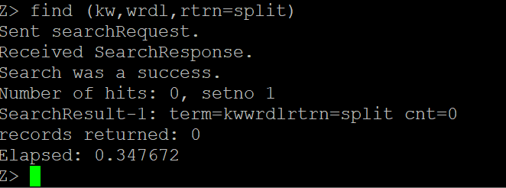
Step 8 : Again write this command: find (kw,wrdl,rtrn=split)

Slide 18
After completing all above configuration Z39.50/SRU has to be configured in the client computer to retrieve records through the Z30.50/SRU,
Move to web browser by typing IP address or domain name.

Slide 19
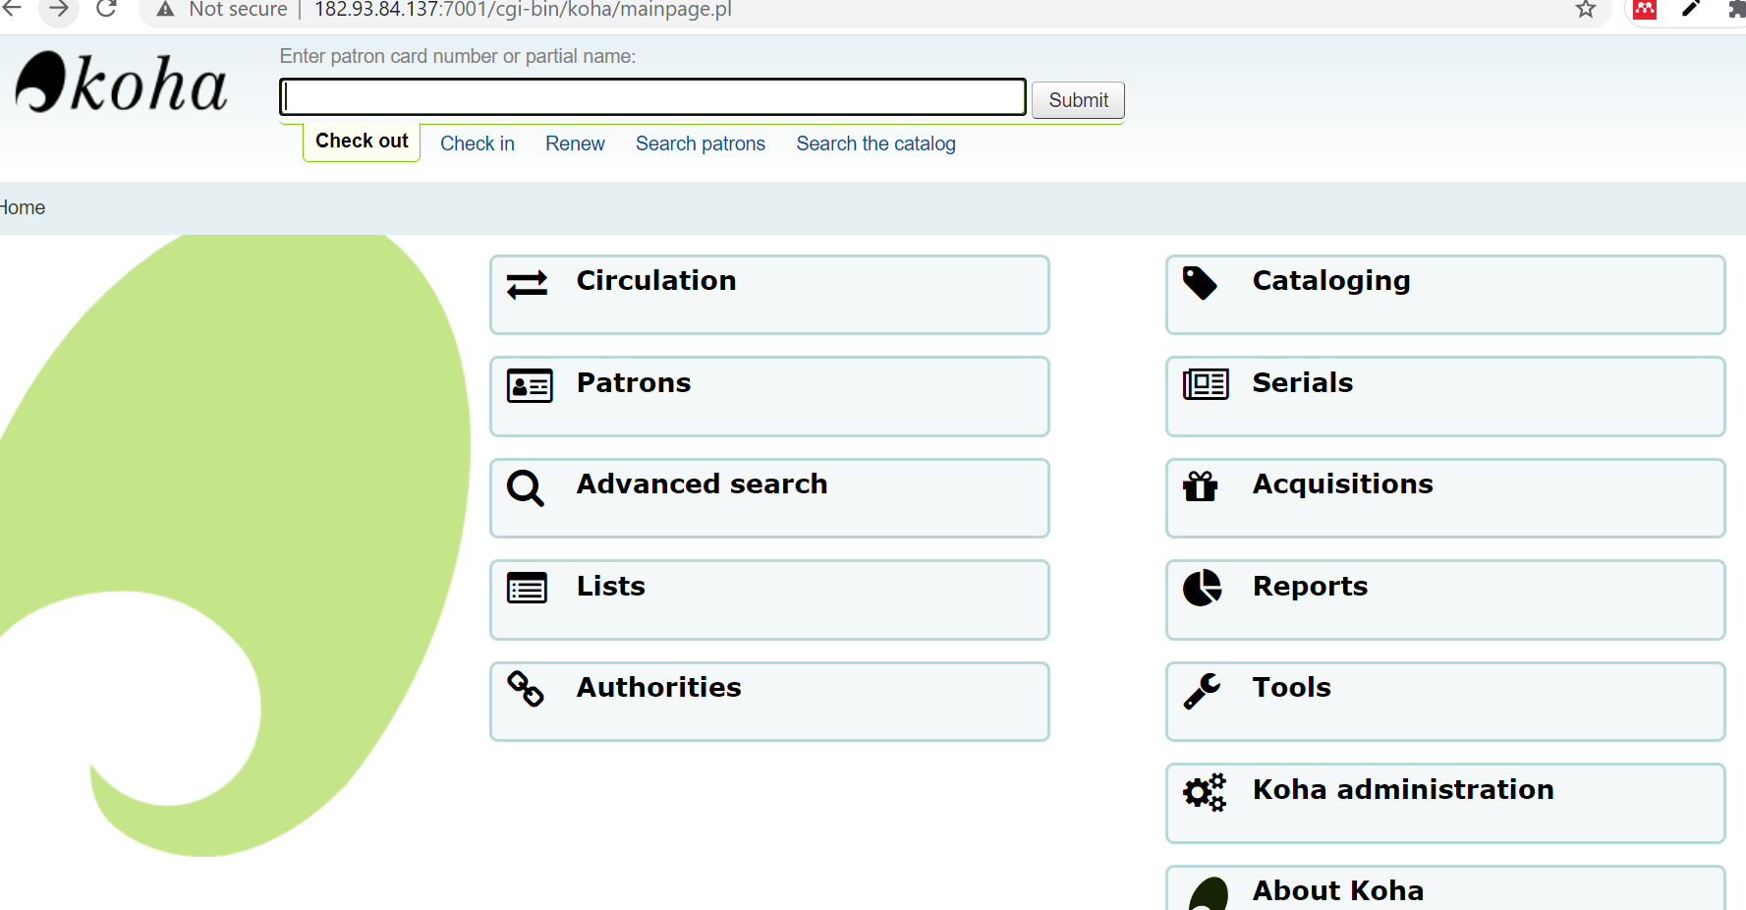
Now for set up Z39.50/SRU servers we should follow the following step:
Step 1. Click Koha administration

Slide 20
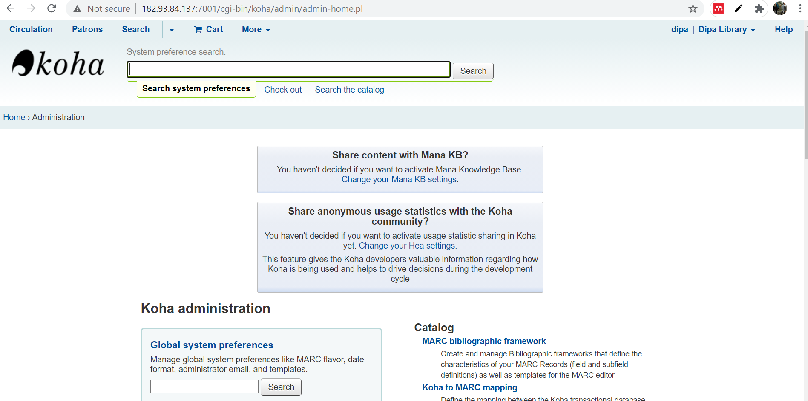
The screen appear like this

Slide 21
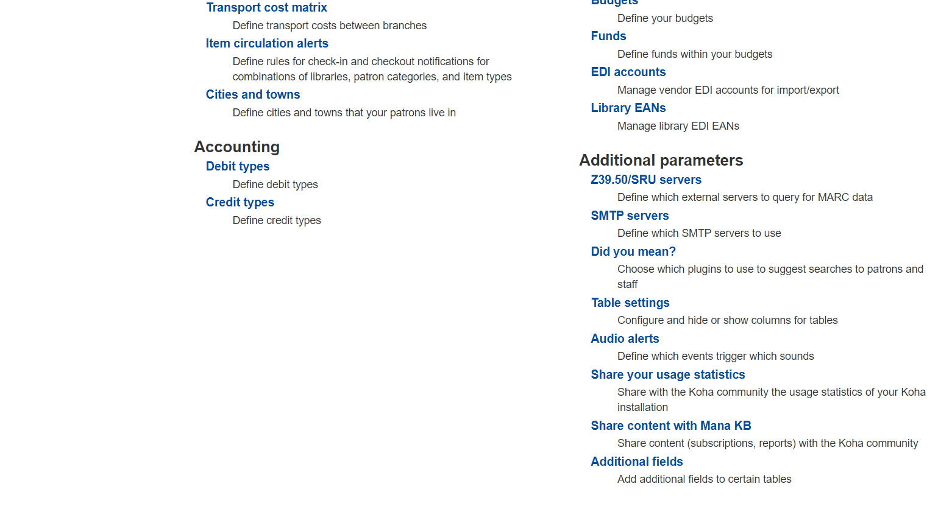
Step 2. Select and click Z39.50/SRU servers under Additional Parameters

Slide 22
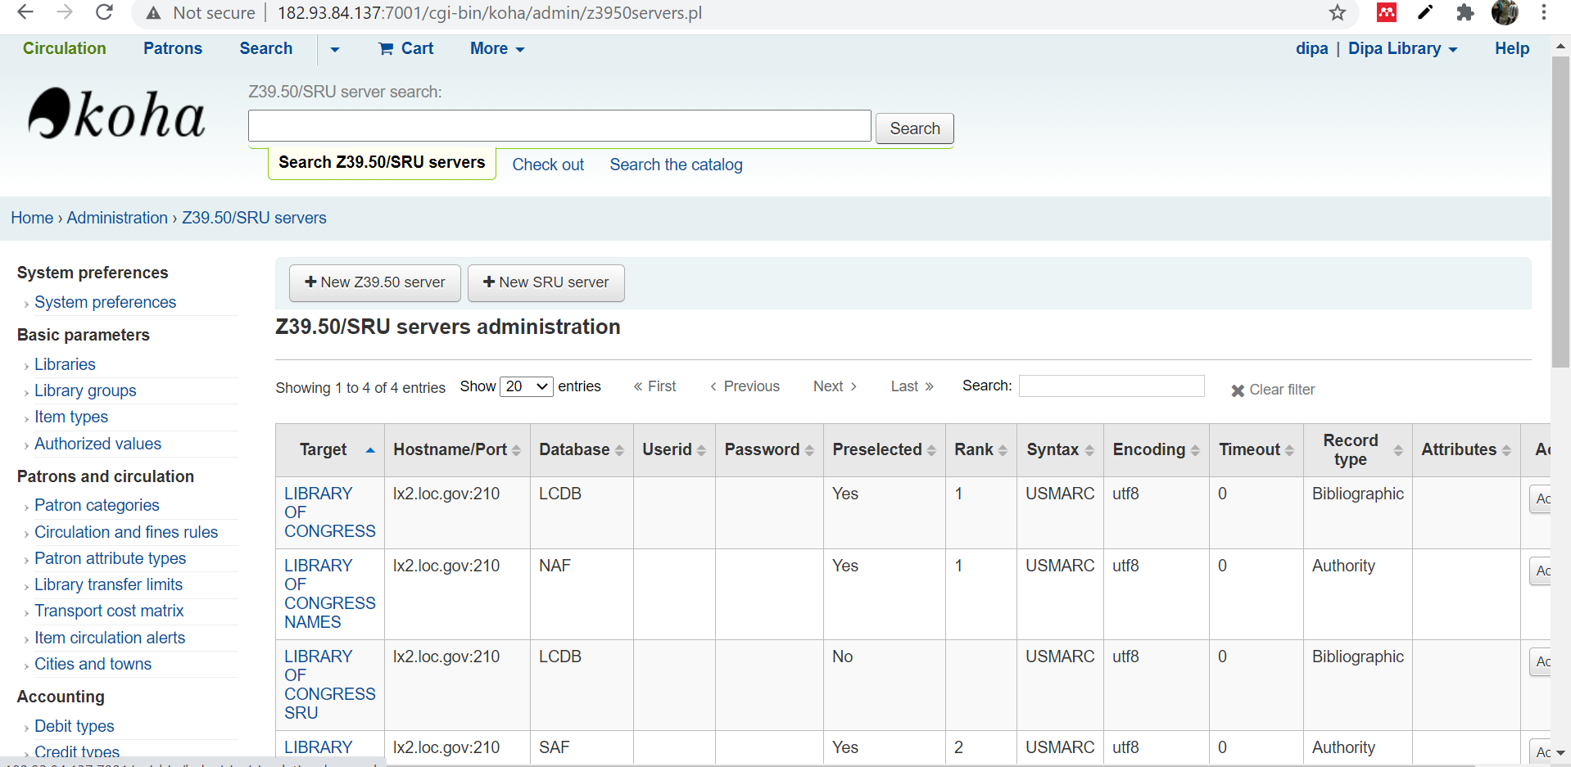
Step 3 : After clicking Z39.50/SRU servers the screen will be appeared and then select “New Z39.50 server”.

Slide 23
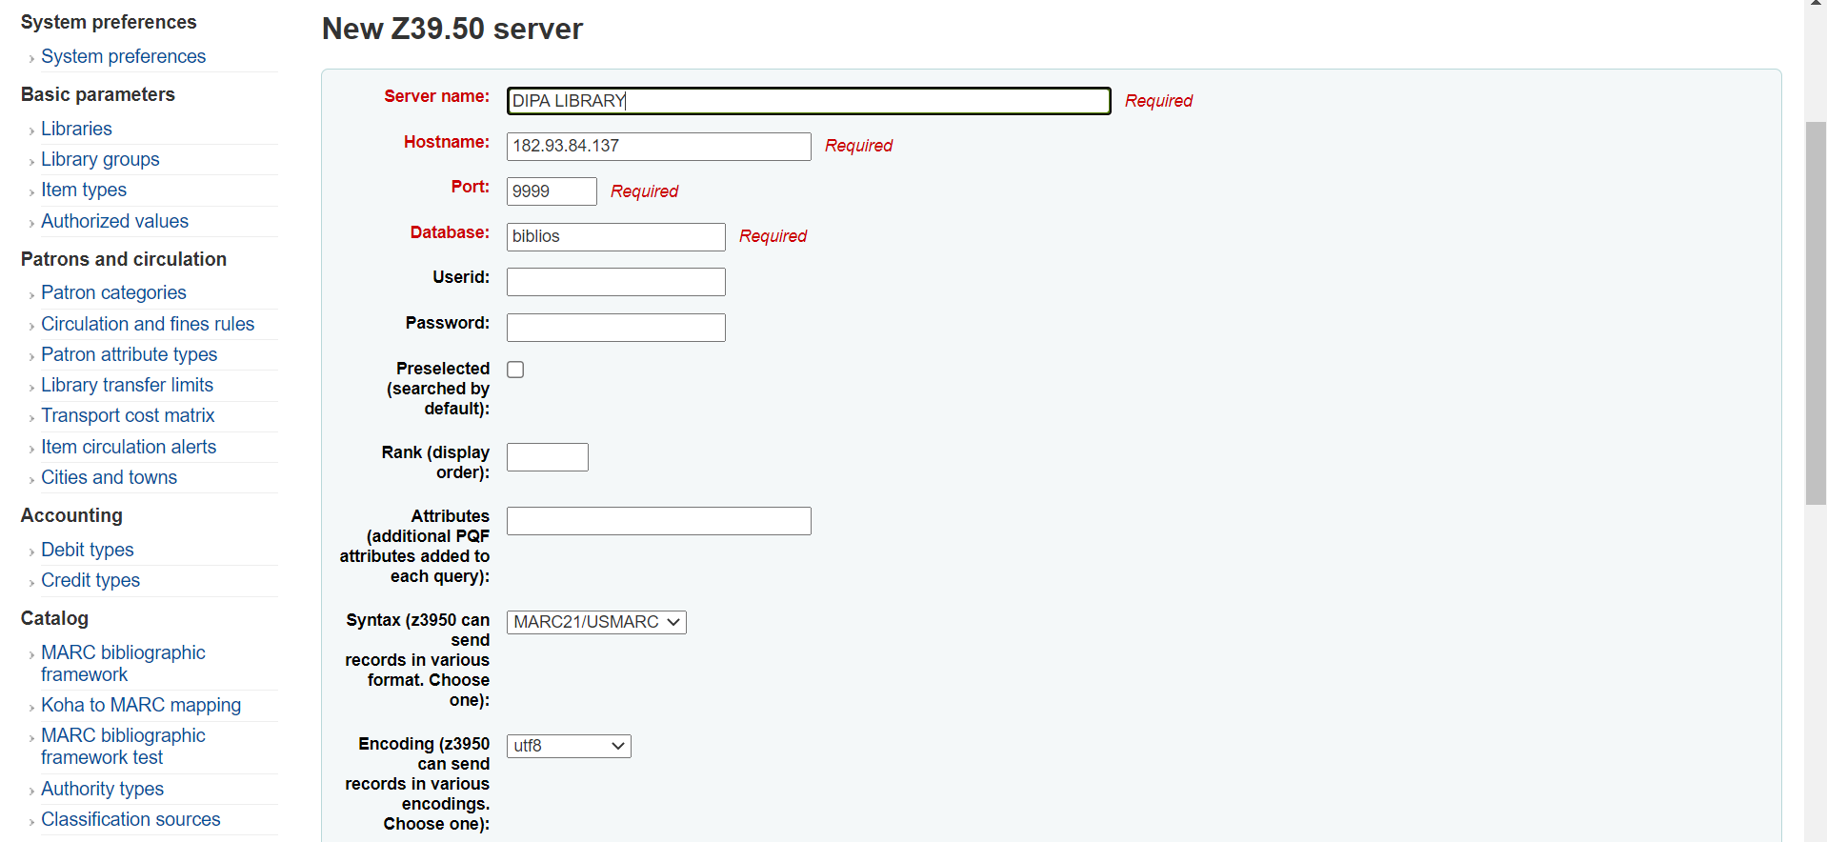
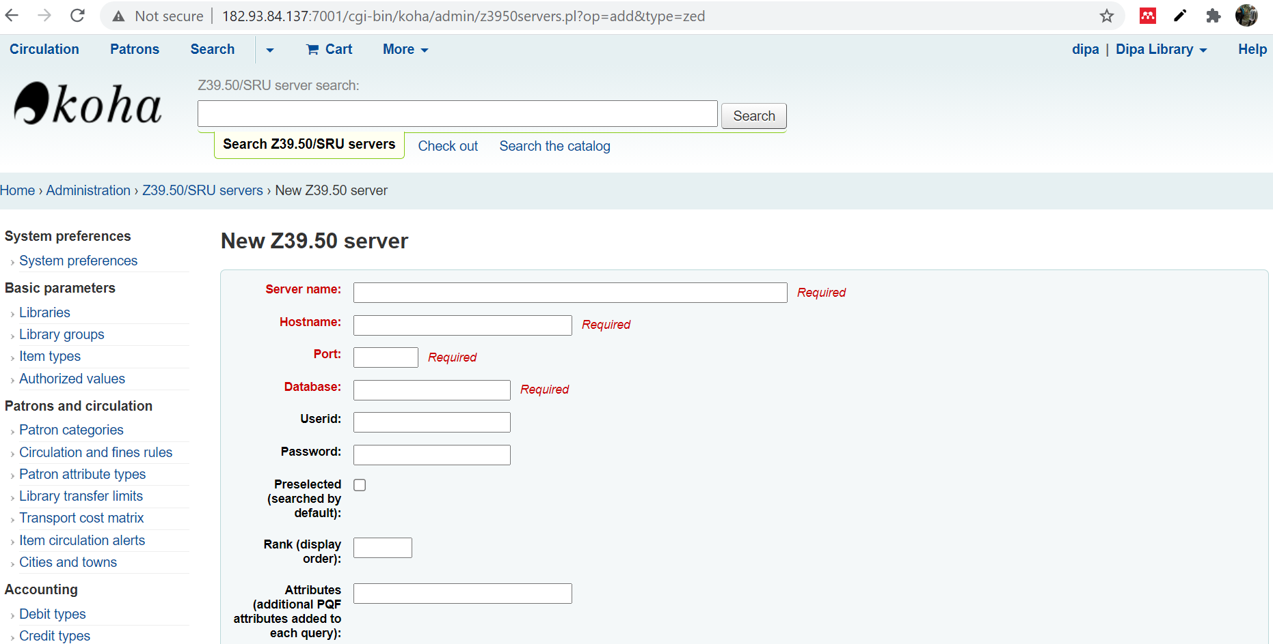
Step 4: When clicking z39.50 server the below screen is available and configure the following details:
Click the save button

Slide 24
Newly configured Z39.50 server is displayed as follows:

Slide 25
For importing bibliographical data :
Go to Home>cataloguing
Select “New from Z39.50/SRU” search tab

Slide 26
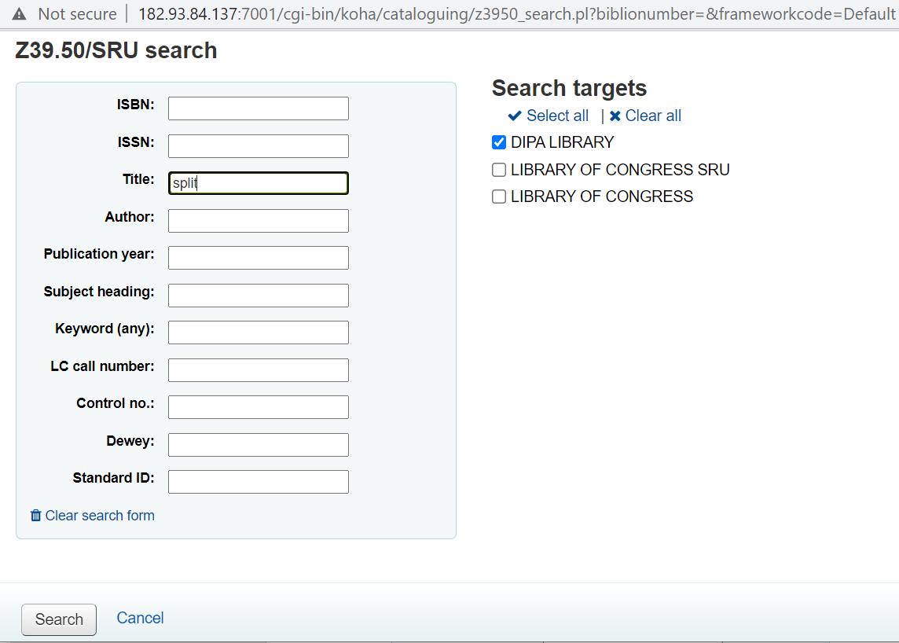
Select the Z39.50 server from where data is going to be imported. In this example Dipa Library is being used:

Slide 28
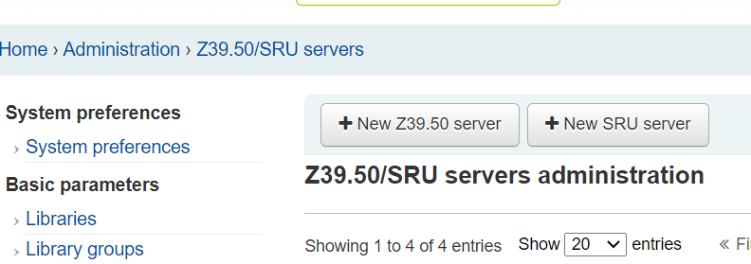
Step 5 : To add SRU server:
Click Koha administration; Select and click Z39.50/SRU servers under Additional Parameters
click New SRU Server.

Slide 29
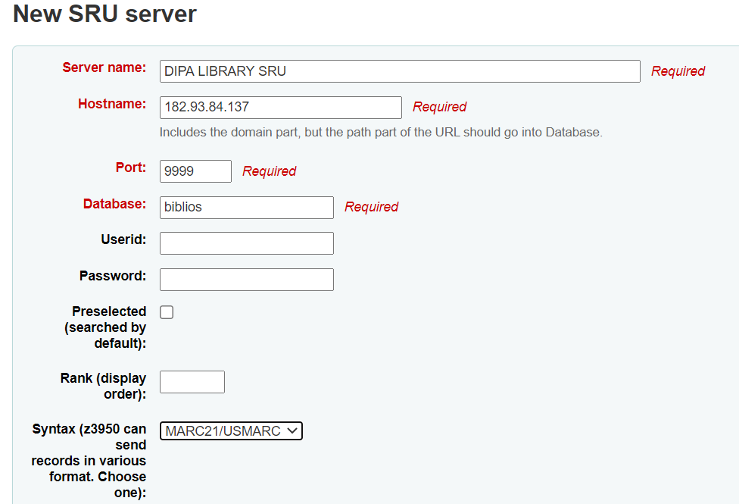
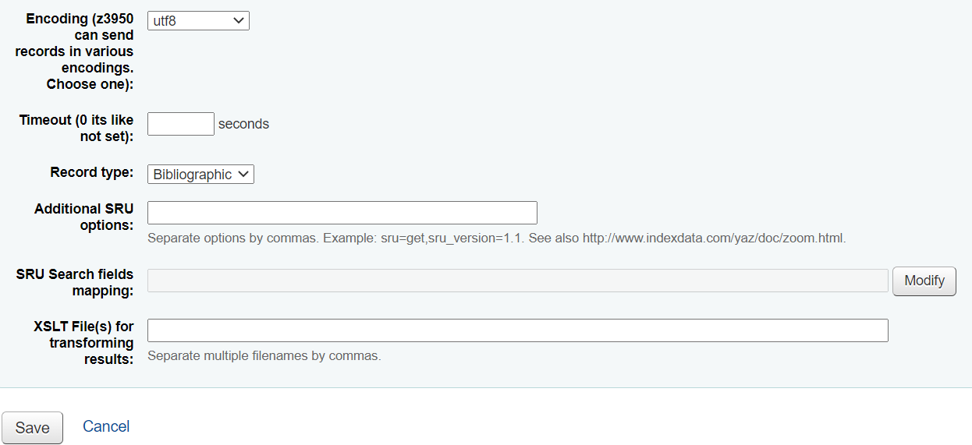
When clicking z39.50 server the below screen is available and configure the following details:
Click save button
Click save button

Slide 30
Step for import bibliographical data from SRU
Home>cataloguing
click the “New from Z39.50/SRU server” button

Slide 31
Select the Z39.50 server from where data is going to be imported. In this example DIPA LIBRARY AND DIPA LIBRARY SRU are being used:

Slide 35
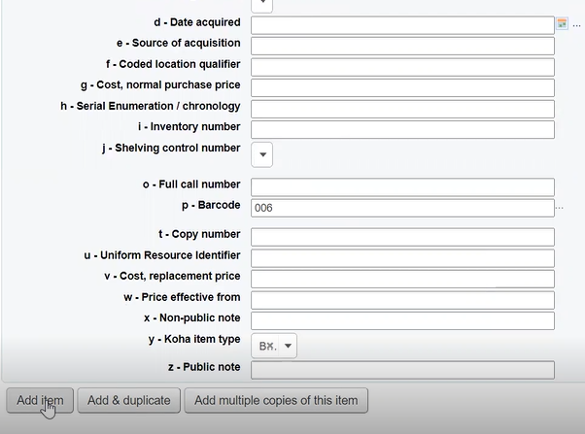

Slide 37
Conclusion
Copy catalogue saves the cost and time. Z39.50 is a protocol for searching and retrieving bibliographic information from a database over a TCP/IP computer network.
After configured above all activities, we can make a local computer act as z39.50/SRU server.
The Z39.50 protocol helps the librarian to improve resource sharing among libraries by creating virtual union catalogue.

Slide 38
References
Pradhan, M. R. [unpublished]. Manual of Koha as z39.50 server
https://wiki.koha community.org/w/index.php?title=Special%3ASearch&search=z39.50&fulltext=Search

